Slide 1

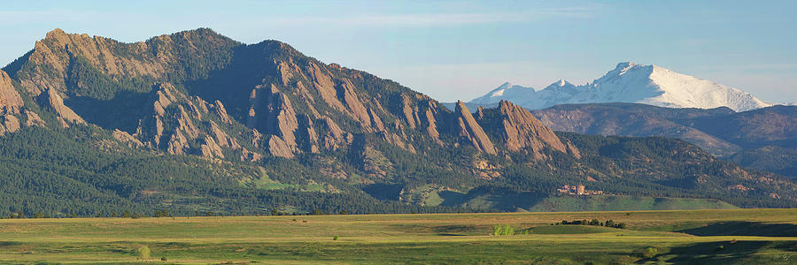
Machine-Learning-Augmented Control of Wind Farms
Photo credit: Aaron Spong
Ph.D. Defense Presentation | Aoife Henry | 05/13/2025
Notes:
1

Slide 2



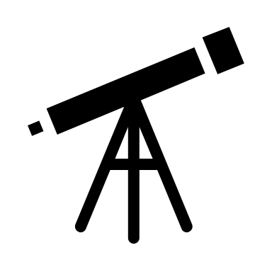
Outline
Motivation for my research
developing the components of a “dream” ML-augmented wind farm controller ...
that are implementable in practice …
and professionally coded as open-source software.
Research completed
statistical and machine learning algorithms
… for turbine-level multivariate multistep probabilistic wind speed/direction forecasting
… integrated with greedy and lookup table control
Future outlook
realizing the full potential of established methods of wind farm control with ML
closing the gap between wind farm control in research and in industry
Notes:
First I’m going to describe the kind of wind farm control methodology I’d like to see developed and implemented and why I think this method could be better than the benchmarks.
Then I’ll give a highlights reel of what I presented at my comprehensive exam, what I promised I would do and the research I have actually accomplished since that I believe contributes to that ideal wind farm controller.
And finally I’ll provide some insights gleaned from not only research, but from the interactions I’ve had with people in the wind energy industry over the latter half of my doctorate, and the outlook I’ve developed on the research we do as a result.

Slide 3
Outline
Motivation for my research
developing the components of a “dream” ML-augmented wind farm controller ...
that are implementable in practice …
and professionally coded as open-source software.
Research completed
statistical and machine learning algorithms
… for turbine-level multivariate multistep probabilistic wind speed/direction forecasting
… integrated with greedy and lookup table control
Future outlook
realizing the full potential of established methods of wind farm control with ML
closing the gap between wind farm control in research and in industry
Notes:
First: the motivation for my research, what a wind farm controller is, what I mean by a machine-learning "augmented" controller, and why I think it could be superior to existing methods.

Slide 4

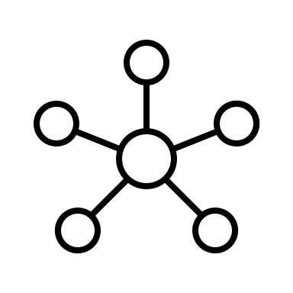

Motivation
Machine Learning-Augmented Control
“white box” control
machine learning-augmented control
machine learning-dominated control
e.g. PID, offline setpoint optimization
e.g. autotuning, modeling, forecasting
e.g. learning the control actions online
GENERAL RESEARCH QUESTION:
How can we integrate machine learning (for forecasting, dynamical system modeling, controlling systems) into wind energy control systems with confidence in the outcomes?
Notes:
This is a spectrum showing control with no machine learning on the left hand side to control that is only machine learning on the right hand side.
On one side we have "white-box" control such as classical control methods, logic based control and offline setpoint optimization. In these cases the controller is interpretable, straightforward but neglects a lot of the nuance in the complex systems with volatile disturbances, like wind farm control for example.
On the other side we have machine-learning "dominated" control like deep reinforcement learning where you equip a system like a wind farm with an AI agent and an objective function, and send it off into the world to learn for itself, how to behave in polite society. In theory, given enough learning time and data this could work, but there is not wind farm operator in business willing to give an AI agent that time or the power losses and risk associated with such a "black box" model.
[click] the question I have been interested in over my PhD relates to the middle-ground, something I've called machine-learning augmented control: How can we integrate machine learning (for forecasting, dynamical system modeling, controlling systems) into wind energy control systems with confidence in the outcomes?

Slide 5
Motivation
Machine Learning-Augmented Control
“white box” control
machine learning-augmented control
machine learning-dominated control
Autotuning Classical Controllers
“Forecast-Enabled” Controllers
Deep Reinforcement Learning
Control Law Modeling
Learning-Based Model Predictive Control
Notes:
At my comprehensive exam, I presented the projects I have worked on across this spectrum, specifically examples related to integrating machine learning into controls include:
- [click] autotuning controllers,
[click] modeling the relationship between classical controller inputs and outputs
[click] *2 integrating forecasts of unruly disturbances, models of dynamical systems or learned cost functions with receding horizon-based controllers like MPC
[click] and deep reinforcement learning
My main proposal at Comps was that of my final journal paper, designing forecast-enabled controllers for wind farm operation. I’ll come back to that, but first, let’s take a step back to define what wind turbine, and wind farm control means.

Slide 6

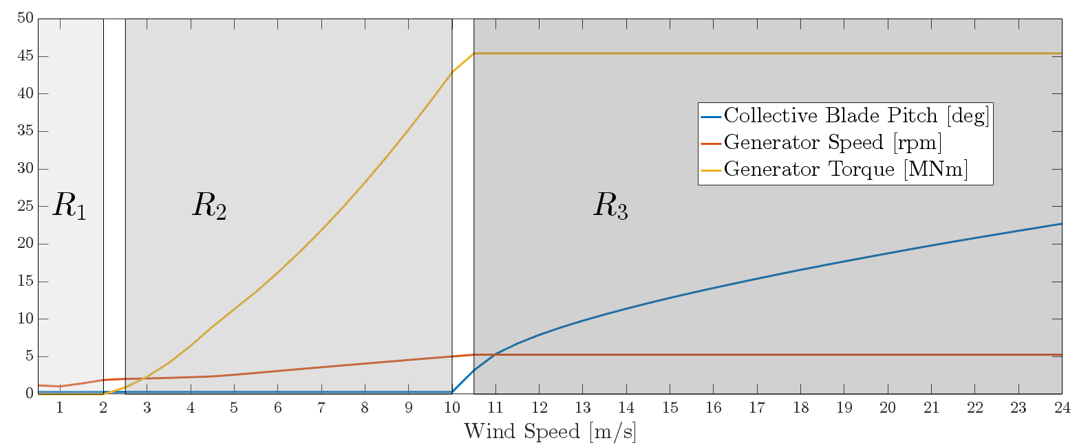
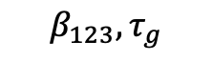
Wind Turbine & Farm Control – A Bird’s Eye View
i.e. an insufficient summary of ½ the audience members’ PhD dissertations…
OBJECTIVES OF WIND TURBINE CONTROL:
Given the measured rotor speed and loads, when the wind speed is:
below rated - track the maximum power
above rated - hold the rated power and mitigate loads
Maximize Power with Generator Torque Control
Hold Power and Rotor Speed at Rated with Blade Pitch Control & Load Mitigation
$$β_{123}, τ_{g}$$
Notes:
Or i.e. an insufficient summary of ½ the audience members’ PhD dissertations… Emily, you’re the only one present who will be exposed to the dry humor scattered throughout this presentation for the first time, so I hope you enjoy it.
The typical control objective of a single wind turbine depends on its ‘region of operation’, or, the speed of the incoming wind relative to its rated value.
[click] The controller reads in values such as the measured rotor (that's the rotating part of the turbine including the blades) speed and loads arising on turbine components.
When the wind speed is below rated, in region 2 here, the objective is typically to track the maximum power achievable using the generator torque actuator, tau_g, which takes milliseconds adjust.
When the wind speed is above rated, the objective is typically to hold the rated power and to mitigate loads using the blade pitch actuators, beta_123 for each of the typically 3 blades, which can rotate on the order of about 5 deg/s.
(We have two main actuators at our disposal here: blade pitch angle of each blade (5 deg/sec), and the generator torque (a time constant an order of magnitude or more faster than that of the rotor speed, 12.1 rpm/72.6 deg/sec for NREL 5MW).)

Slide 7
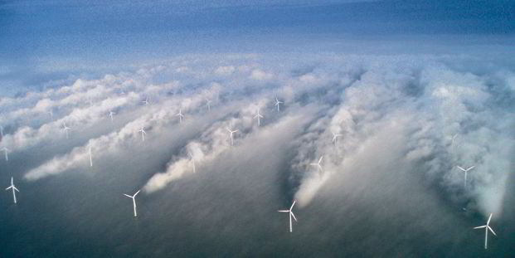
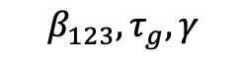
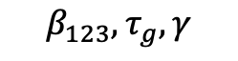
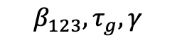
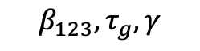
Wind Turbine & Farm Control – A Bird’s Eye View
i.e. an insufficient summary of ½ the audience members’ PhD dissertations…
OBJECTIVES OF WIND FARM CONTROL:
Given the measured wind speed/direction and loads, maximize total power generation, minimize/equalize mechanical loads, track a power reference, cooperate with other renewable energy sources/energy storage systems, provide ancillary services, capitalize on price arbitrage, subvert Big Oil …
Wind Velocity ↓
Turbulence ↑
The dreaded wake effect
$$β_{123}, τ_{g}, γ$$
$$β_{123}, τ_{g}, γ$$
$$β_{123}, τ_{g}, γ$$
$$β_{123}, τ_{g}, γ$$
Photo credit: Christian Steiness / Vattenfall
Notes:
If we put a collection of these turbines together, we have built a wind farm.
But wind turbines located in close proximity to eachother without cooperating introduces a new issue … the wake effect.
This is when high turbulence and low velocity wakes propagate from upstream turbines, and are incident on downstream turbines. This reduces the overall power generated by the farm and results in unequal loading across turbines.
The goals of wind farm control are, [click], given the measured wind speed/direction and loads, maximize total power generation, minimize/equalize mechanical loads, track a power reference, cooperate with other renewable energy sources/energy storage systems, provide ancillary services, capitalize on price arbitrage, subvert Big Oil
… by using the torque generator and blade pitch signals I introduced in the last slide, as well as the yaw angle of each turbine, or the direction it is facing about a vertical axis.

Slide 8
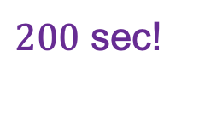
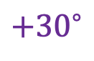
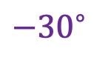
The Trouble with Wind Farm Control…
… (locally) ‘greedy’ control i.e. pointing all turbines to ‘look at the wind’, is not globally optimal.
Total Power ↓
Turbine Loading ↑
The dreaded wake effect
Yaw Offset
$$−{30}^{∘}$$
$${+30}^{∘}$$
$200$ sec!
Notes:
The naïve way of controlling the yaw offsets in a wind farm to maximize power generation is ‘greedy’ control, whereby every turbine is yawed to face the incoming wind. The problem with this approach is that it exacerbates the wake effect, so downstream wind turbines experience lower wind speeds with higher turbulence, resulting in an overall sub-optimal power production and unequal fatigue loading.

Slide 9
The Trouble with Wind Farm Control…
… lookup table (LUT) control is better … but is optimized for steady-state wake models, usually relies on delayed measurements, and suffers from high yaw activity.
Total Power ↑
Yaw Activity↑
The dreaded wake effect
Yaw Offset
$$−{30}^{∘}$$
$${+30}^{∘}$$
$200$ sec!
Notes:
A better approach is "wake steering", which means yawing upstream turbines to redirect wakes such that they have less of a detrimental influence on the downstream turbines. Lookup table, or LUT, control is currently the most-established implementation of wake steering, where yaw offsets of a given wind farm layout are optimized offline for a grid of wind speeds and directions. The problems with this approach is that a) it is optimized for steady-state conditions, although wakes are never in steady state, b) is based on low-pass filtered historic wind direction rather than the incoming wind, and c) tends to suffer from high yaw activity as it changes for variable wind directions.

Slide 10
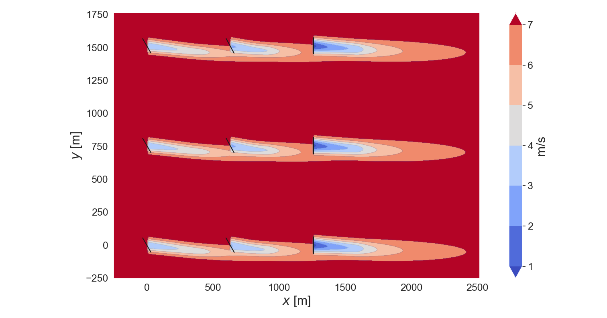
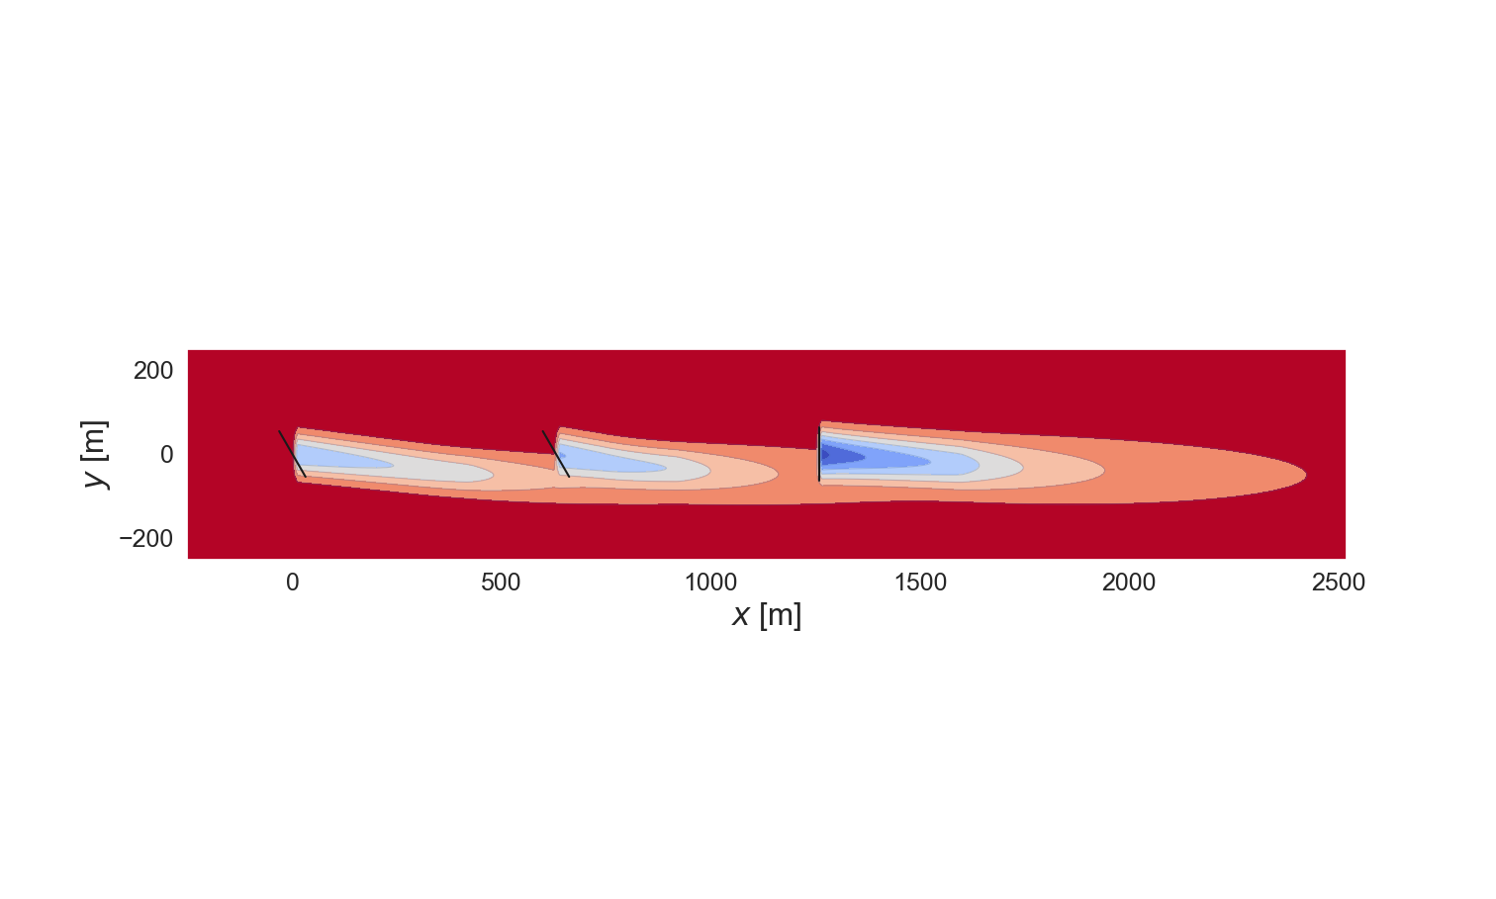
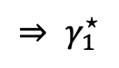
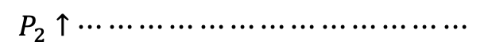
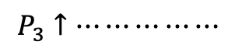
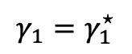
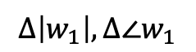
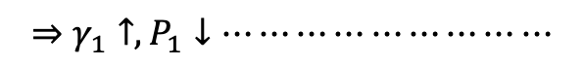
The Trouble with Wind Farm Control…
The time scales of wake propagation and yaw actuation are not instantaneous…
630 m
90 sec
1260 m
180 sec
T1
$$Δ\left|w_{1}\right|, Δ∠w_{1}$$
$$⇒ γ_{1}^{⋆}$$
$$⇒γ_{1}↑, P_{1}↓⋯⋯⋯⋯⋯⋯⋯⋯⋯$$
$$γ_{1}=γ_{1}^{⋆}$$
T2
$$P_{2}↑⋯⋯⋯⋯⋯⋯⋯⋯⋯⋯⋯⋯⋯$$
T3
$$P_{3}↑⋯⋯⋯⋯⋯$$
0
90
100
180
200
Time [sec]
Notes:
Let me explain why a controller based on low pass-filtered historic measurements and steady-state conditions is a problem. Take this 3-turbine wind farm with a westerly freestream wind speed of 7m/s.
First event: [click] the wind speed or direction at the most upstream turbine changes.
Second event: [click] this causes that turbine to change its yaw angle (gamma), either based on Greedy control or LUT control. For this wind speed and direction, the optimized lookup table yaw offsets are 30deg, 30deg, and 0deg, to [click] steer the wake away from the downstream turbines and boost their power output, at the expense of lowering the power of this offset turbine.
Let's just consider the yawing of this first turbine. At a yawing rate of 0.3 deg/s, it will take it [click] 100 seconds to reach yaw offset of 30 deg. A lot can happen in terms of wind direction changes in 100 seconds, and yawing based on previous measurements doesn’t take this variability into consideration. Additional delays are introduced by the low pass filtering AND the thresholding operation.
Now these changes, of wind speed, wind direction, and upstream yaw angle, will change the wake behind this turbine, but wakes move slowly, at approximately the speed of the wind, so 7m/s in this case. This means that the second turbine will not experience the effects of this deflected wake until [click] 90 seconds later, when its power will begin to increase [click], and the third turbine will not experience the effects until [click] 180 seconds later, when its power will begin to increase [click]. “Steady-state” refers to the conditions at each turbine once the wake resulting from upstream changes has propagated downstream, but as you can see, this takes a while, and optimizing yaw offsets for steady-state conditions is not realistic.

Slide 11
The Trouble with Wind Farm Control…
… and then there are all the unknowns.
Incoming wind
speed/direction?
Influence of wake
on downstream turbines?
Incoming wind
speed/direction?
Influence of wake
on downstream turbines?
The dreaded wake effect
electricity demand
Notes:
There are a few important but unknown signals that impede our noble quest to yaw turbines in a globally optimal fashion.
a) We don’t know what the incoming wind direction or speed will be in the coming minutes
b) It is infamously hard to model how the the wind speed and direction experienced, and power generated by, downstream turbines will change for changing upstream turbine yaw angles. On one hand we have analytical steady-state models, which are implemented in the NREL toolbox FLORIS (FLOw Redirection and Induction in Steady State), and which tend to be less accurate but computationally efficient, on the other hand we have LES simulations which are more accurate but very slow to compute.

Slide 12


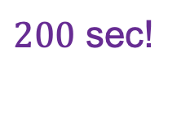
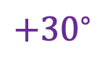
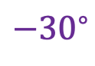
The “Dream” Wind Farm Controller
Centralized or distributed controller than can
… read wind speed/direction/power measurements
… write control setpoints (generator torque, blade pitch, yaw offset, floating platform location) for each turbine
… to achieve the complex, time-varying, and composite objectives mentioned earlier…
… within the actuator constraints.
Model Predictive Control !
Yaw constraints ?
System modeling ?
Wind uncertainty ?
$$−{30}^{∘}$$
$${+30}^{∘}$$
$200$ sec!
Notes:
An alternative, more harmonious control approach would be to have …
To make sure I’m keeping your expectations in check – I haven’t figured all of this out yet and am unlikely to so before graduation, but I’m trying to make a dent in it.
Sounds like.... [click] model predictive control could be a candidate solution, but for this, as the name might suggest, .... [click] we need a model describing how the wind and the control actions of the turbines influence the wake inside the farm for some future horizon, AND, it would be really helpful to have an estimate of what the wind will do over that future horizon too.

Slide 13
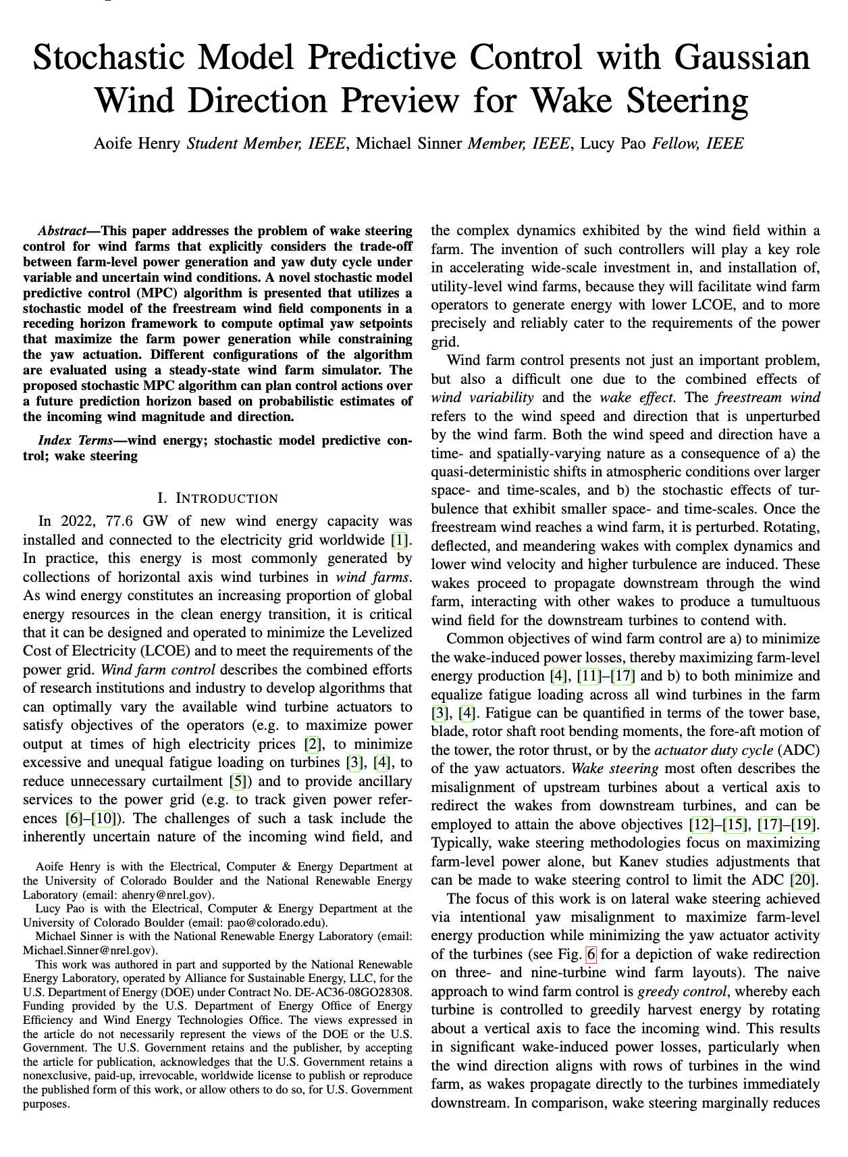


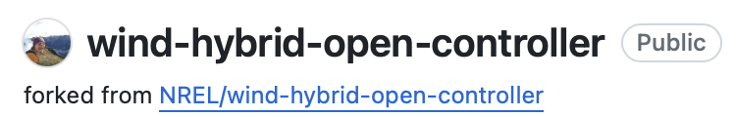
Journal Paper #2
Stochastic MPC with Gaussian Wind Direction Preview for Wake Steering
“white box” control
ML-augmented control
ML-dominated control
IEEE Transactions on Control Systems Technology, 2025
Notes:
After a few pendulum swings to-and-fro along this spectrum, my goals are presently, and until the end of my PhD, situated right in the middle (as I've defined it, conveniently enough) – to create a controller for wind farms that is augmented with a ML-forecasted preview of the wind direction, and a ML-model of the wake influence within the farm.
The second journal paper I submitted was a an effort to try to realize a version of this ideal controller with model predictive control. I tested incorporating several different previews of the wind including a stochastic Gaussian preview, as well as persistence, and a perfect preview.

Slide 14
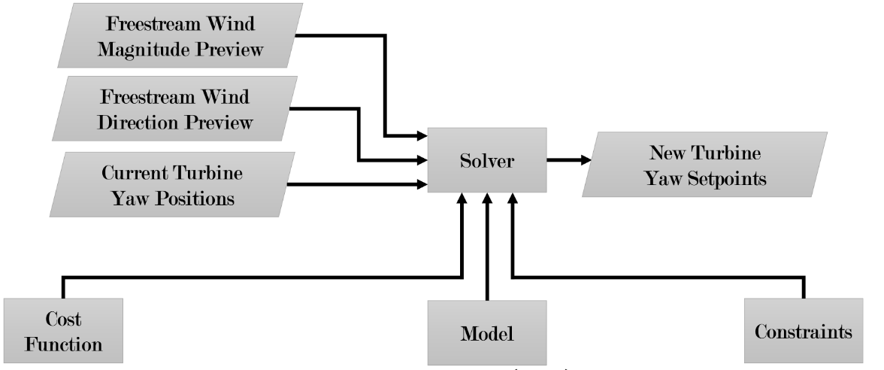
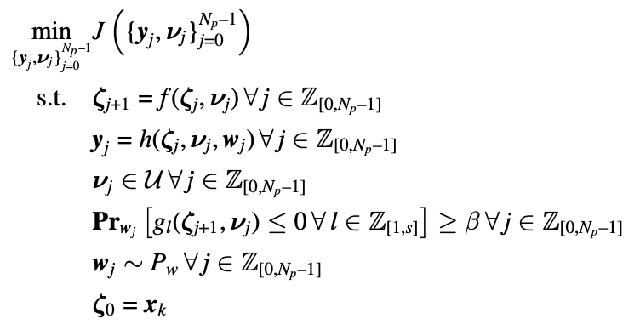
Journal Paper #2
Stochastic MPC with Gaussian Wind Direction Preview for Wake Steering
Notes:
This is an overview of my MPC framework and the optimal control problem solved.
We have a solver which reads in the stochastic preview of the freestream wind magnitude and direction [click], these are the stochastic disturbances, w, as well as [click] measurements of the current turbine yaw setpoints, these are the states, zeta or x.
We provide this solver with a [click] model of how we expect those yaw setpoints to vary with time and the power outputs that results from a set of yaw setpoints and wind conditions, these are the dynamical system model and output function, respectively.
We also provide the solver with [click] cost function, and the [click] probabilistic constraints on the yaw setpoints.
This solver then solves the optimal control problem on the right, and outputs the [click] best changes to make to the turbine yaw setpoints, these are the control inputs, u.
I’ll break each of these lines down in the next few slides.

Slide 15
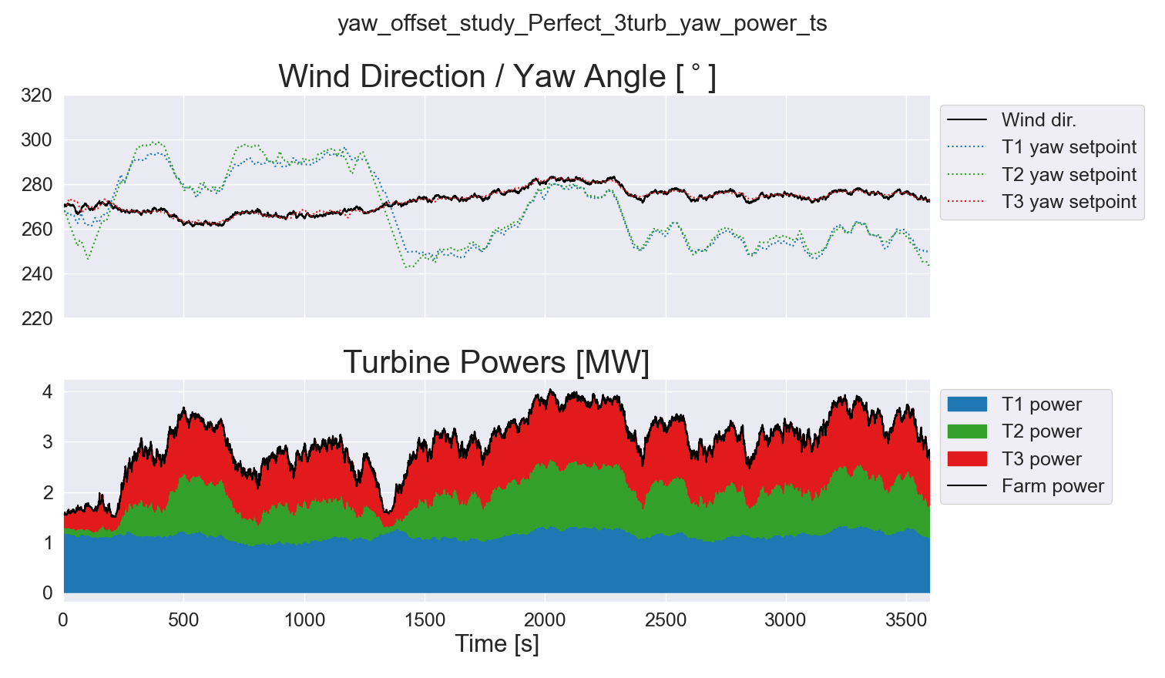
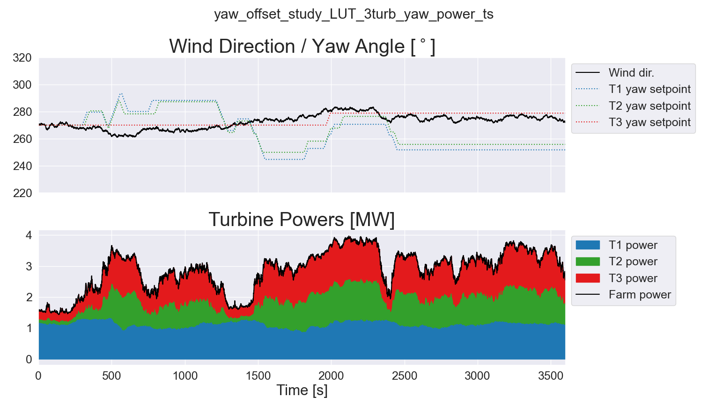
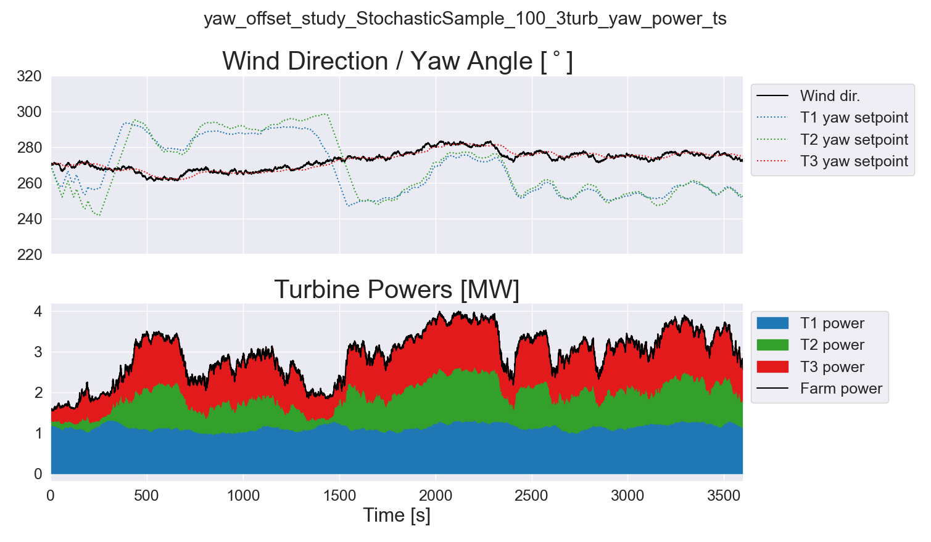
Journal Paper #2
Motivation for Forecast-Enabled Model-Based Control
LUT wo/ Preview
MPC w/ Stochastic Preview (+2.6% Farm Power, +76% Yaw Activity))
MPC w/ Perfect Preview (+5.7% Farm Power, +148% Yaw Activity)
Notes:
So the good news is that we did actually achieve superior farm power of 2.6% compared to the LUT approach, and even better for a perfect preview. These numbers are significant by industry standards. This motivated me to create a a true forecast of the wind experienced by downstream turbines or the power generated by them to transform this into a complete ML-augmented controller, to try and get closer to this perfect preview effect, short of employing divination.

Slide 16
Outline
Motivation for my research
developing the components of a “dream” ML-augmented wind farm controller ...
that are implementable in practice …
and professionally coded as open-source software.
Research completed
statistical and machine learning algorithms
… for turbine-level multivariate multistep probabilistic wind speed/direction forecasting
… integrated with greedy and lookup table control
Future outlook
realizing the full potential of established method of wind farm control with ML
closing the gap between wind farm control in research and in industry
Notes:
For the next part of my presentation, I’ll give an overview of this forecasting project I’ve bene engrossed in since my comprehensive exam.

Slide 17
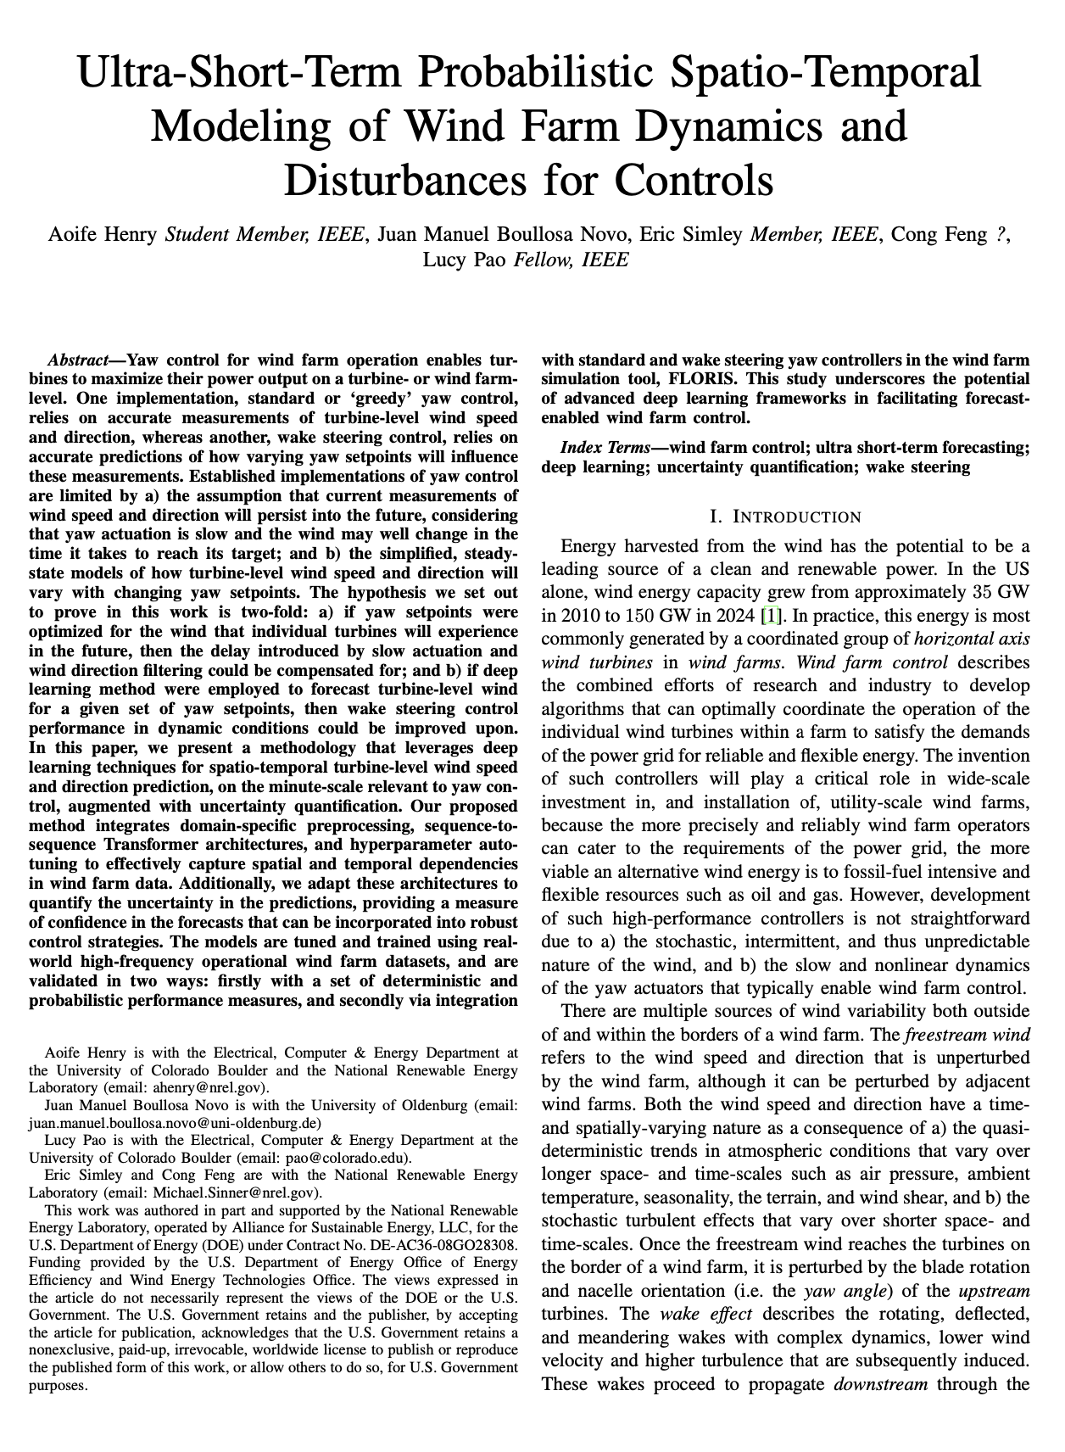
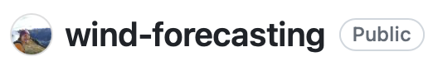
Journal Paper #3
Ultra-Short-Term Probabilistic Spatio-Temporal Modeling of Wind Farm Dynamics and Disturbances for Controls
“white box” control
ML-augmented control
ML-dominated control
IFAC Engineering Applications of Artificial Intelligence, 2025
Notes:
We’re hoping to submit to the IFAC Engineering Applications of Artificial Intelligence journal shortly, as soon as I figure out how to cut this eyesore of an abstract to a half the size.

Slide 18
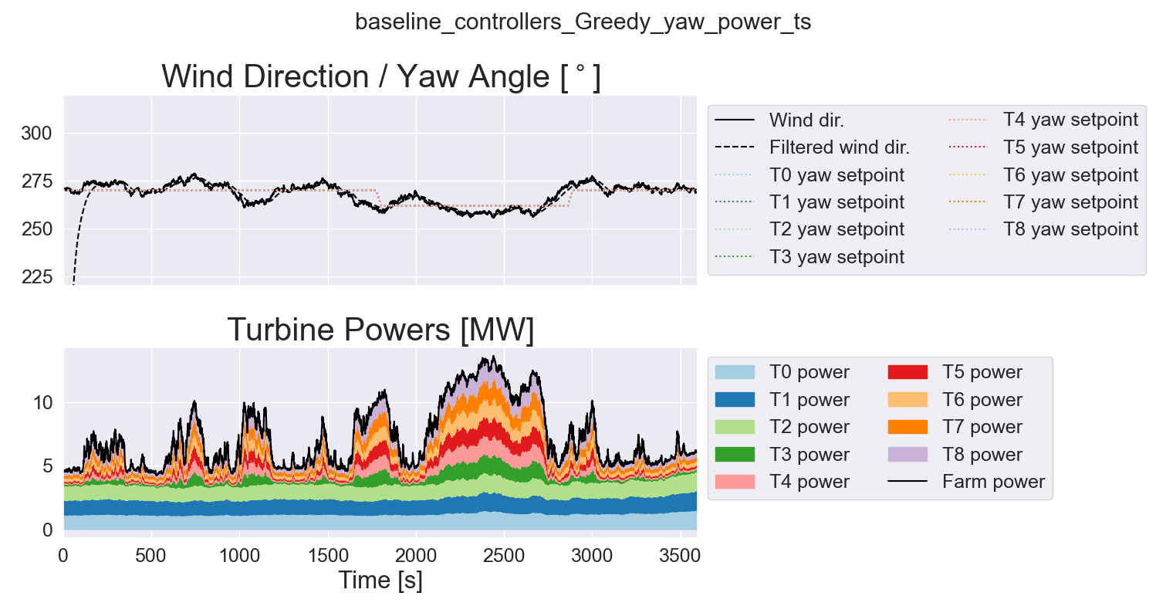
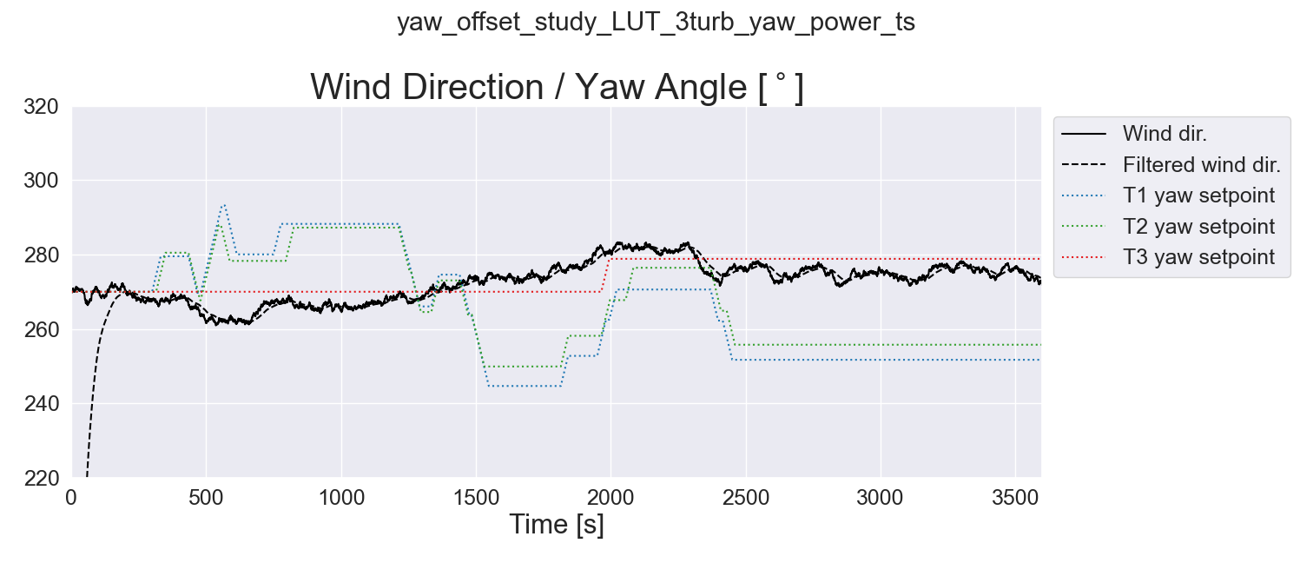
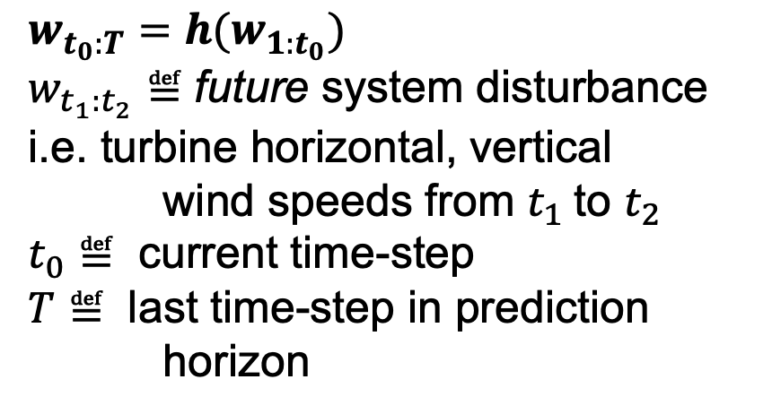
The Problem (or subset of it resolvable within the budget/timeline/powerlessness of a PhD)
Time-Series Forecasting Problem #1:
by the time yaw setpoints have been updated by the LUT …
the wind direction has already changed
Wind Direction
LPF’d Wind Direction
Turbine Yaw Setpoints
$$w_{t_{0}:T}=h(w_{1:t_{0}})$$
$w_{t_{1}:t_{2}}≝$ future system disturbance i.e. turbine horizontal, vertical wind speeds from $t_{1}$to $t_{2}$
$t_{0}≝$ current time-step
$T≝$ last time-step in prediction horizon
Notes:
My motivation for this project is two-fold… firstly that of time-series forecasting of the wind disturbance. The lookup table yaw control shown in this time-series is slow, remember 100 seconds for 30 degrees of change, so when control actions are determined based on low-pass filtered wind directions, by the time the turbines reach those setpoints they may well be far from optimal.
The forecasting problem is that of [click] predicting a disturbance, w, in our case the horizontal and vertical wind speed components, over some future control horizon, from the current time, t0, to the end of the prediction horizon, capital T, GIVEN, the historic measurements of the wind since the first time step 1

Slide 19
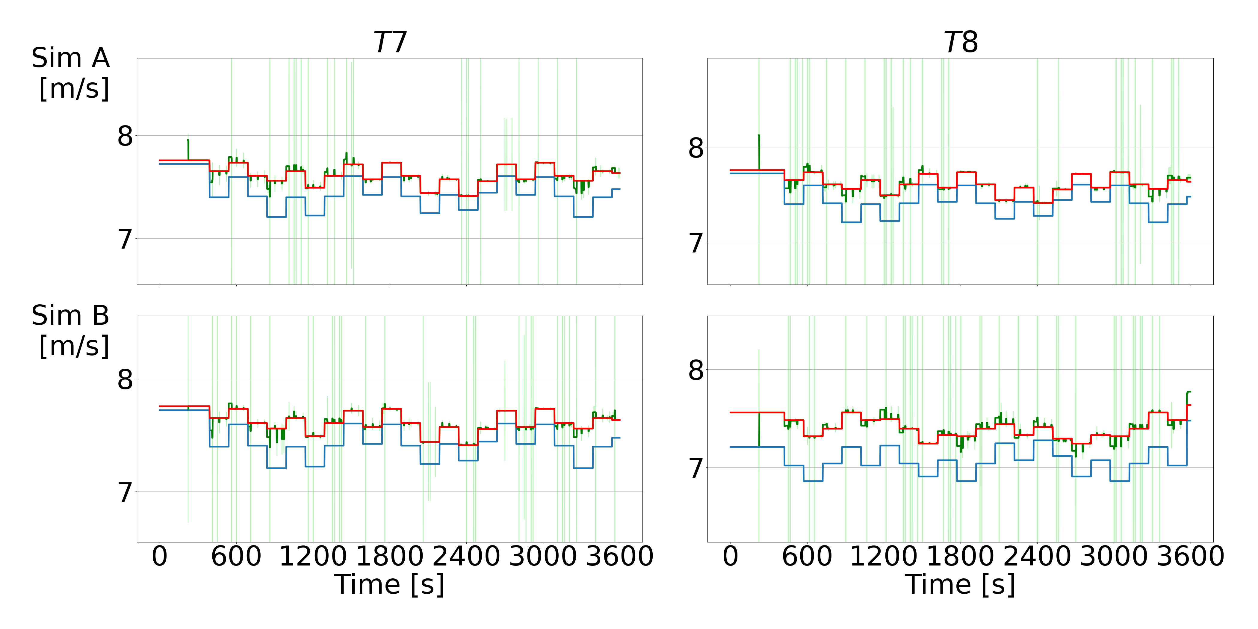
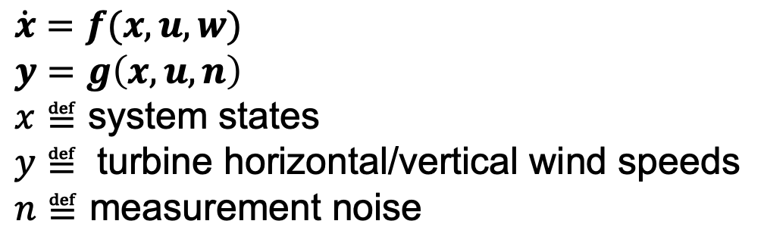
The Problem (or subset of it resolvable within the budget/timeline/powerlessness of a PhD)
Dynamical System Modeling Problem #2:
to find the yaw setpoints that will maximize farm power/minimize fatigue etc. …
we need to know how upstream yaw setpoints impact downstream turbines
True
Base Model-Predicted
GP-Predicted Mean
GP-Predicted Std. Dev.
$$\dot{x}=f(x, u, w)$$
$$y=g\left(x, u, n\right)$$
$x≝$ system states
$y≝$ turbine horizontal/vertical wind speeds
$n≝$ measurement noise
Henry, Aoife, et al. "Online Learning of Effective Turbine Wind Speed in Wind Farms." 2023 62nd IEEE Conference on Decision and Control (CDC). IEEE, 2023.
Notes:
The second part of the problem I’m interested in, is that of modeling how changes in yaw setpoints of upstream turbines will influence the wind speed and direction experienced by downstream turbines.
This “wake effect modeling” problem is that of [click] learning the function, g, to model the outputs, y, for example the turbine powers/wind speeds/wind directions, as a function of system states, x, control inputs, u, disturbances, w, given the measurement noise, n.

Slide 20
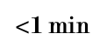
Gap in the Research
Related Works
Target Variable(s)
Farm Power
Including Yaw Setpoints
Station Wind Speed
Probabilistic Predictions
Station Wind Direction
Both
Turbine Powers
Neither
Henry et al. 2025
Turbine Wind Speeds
Turbine Wind Directions
$<$1 min
5 min
10 min
15 min
1 hr
3+ hrs
Prediction Interval
Notes:
I made this plot to illustrate what existing works in the space of applying deep learning to forecasting for wind energy, have focused on, in terms of the time steps they make predictions for on the x-axis, and the target variables they model on the y axis.
As you can see, a lot of emphasis has been given to farm-level or single point measurements: the total power produced by a farm or the wind speed measured at a single station. There have been some works on forecasting individual turbine wind speeds and powers, with two including the influence of variable yaw angles, but all of these make predictions on a time scale of 10+ minutes, and very few quantify the uncertainty in the predictions.
With my continuing work, the goal is to focus on turbine-level wind predictions on time scales that are useful for controls with uncertainty quantification.

Slide 21

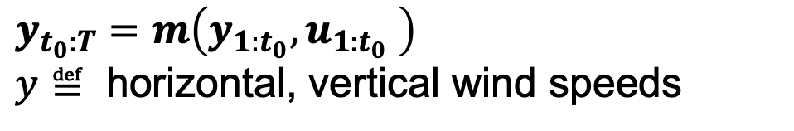
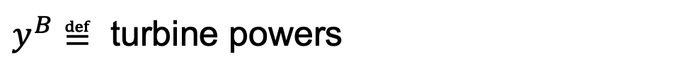
Model Inputs/Outputs
Historic wind speed/direction/yaw measurements
→ Ultra-short-term probabilistic wind speed/direction predictions
+ set of future yaw setpoints
All Turbine Horizontal Wind Speeds
Deep Learning !
$$y_{t_{0}:T}=m\left(y_{{1:t}_{0}}, u_{1:t_{0}} \right)$$
$y≝$ horizontal, vertical wind speeds
All Turbine
Vertical Wind Directions
Wind Forecast
+ Wake Model
Selected Future Turbine
Horizontal, Vertical Wind Speeds
Forecast-Enabled Greedy/LUT Controllers
All Turbine
Control Setpoints
$y^{B}≝$ turbine powers
✅ Learn future wind from historic wind measurements (forecasting)
Turbine Powers
✅ Learn future turbine powers from historic yaw setpoints (modeling)
✅ Learn uncertainty of these predictions
Wind Forecast + Wake Model B
Future Turbine Powers
(my) MPC
Notes:
The goal of this project is to create a [click], model, m, that will read in the [click] historic outputs of the turbine horizontal and vertical wind speed components from the initial time step to the current one, as well as the [click] control setpoints, and output a [click] multi-step, multivariate forecast of multiple turbines' horizontal and vertical wind speed components, which can then be used as a [click] forecast signal for a greedy controller of a lookup table controller.
Considering how many variables are involved here and the nonlinearity of the dynamics, deep learning [click] could be a good solution.

Slide 22
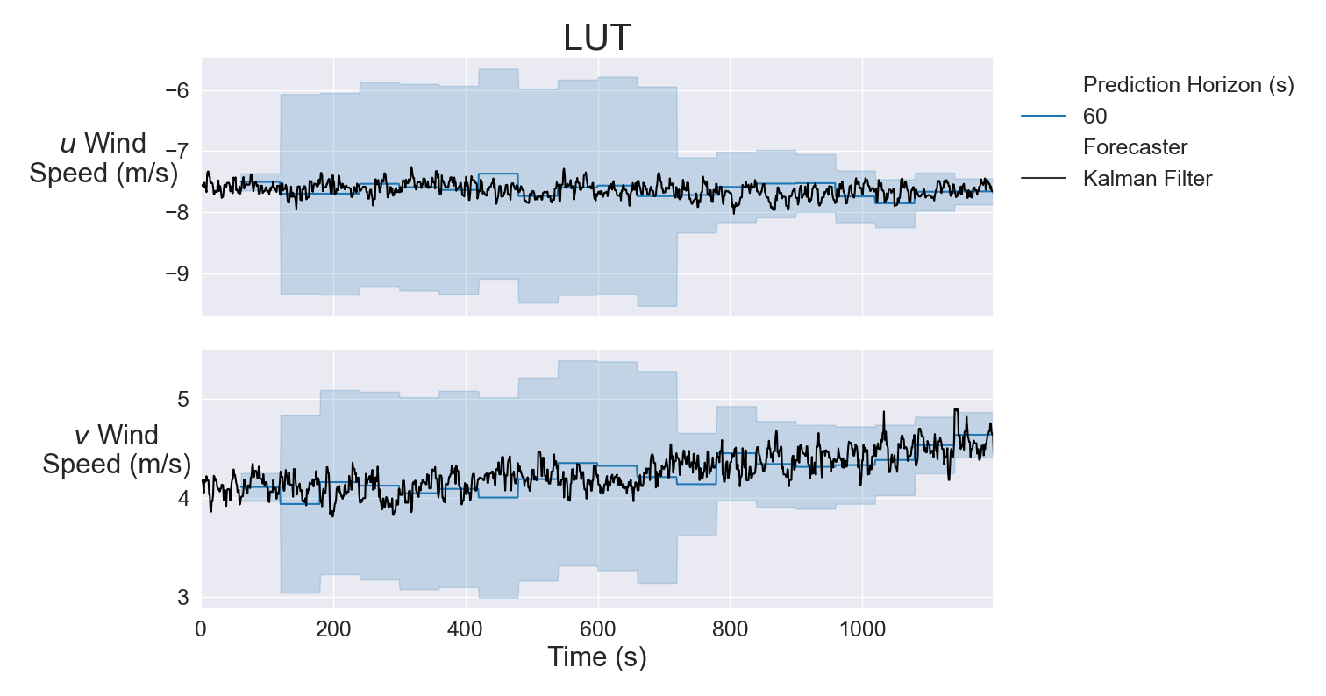
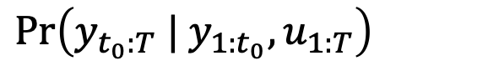
Model
Open-Source Framework for…
Multistep
Multivariate
Probabilistic
Minute-Scale
Spatio-Temporal Forecasting
of Turbine-Level Wind Speed/Direction Measurements
Considering Yaw Angles as Inputs
Uncertainty Layer
Predict Probability Distribution Parameters
Weight Uncertainty
Predict quantiles
$$\text{Pr}\left(y_{t_{0}:T} | y_{{1:t}_{0}}, u_{1:T}\right)$$
Notes:
We are going to investigate the use of transformers, or attention-based encoder-decoder architectures for our models.
The data we have for training and validation is from the The American WAKE experiment, or AWAKEN, and covers 18months of wind turbine data with a 5 second sampling rate. We will need to process this data to account for outliers, missing data, offline turbines, and nacelle calibration, as well as normalization, and transformation of circular quantities such as wind directions and yaw angles.
The second layer is the spatiotemporal transformer architecture, where the spatiotemporal part will capture spatial correlations between measurements at different turbine locations, as well as temporal correlations between different time-steps.
The third layer required is one which can quantify the uncertainty in the predictions. In a controls context this can enable the controller to be more aggressive when the certainty is high, and more conservative otherwise.
All of this will come together to create an … which will predict the probability distribution of the outputs, y, over a prediction horizon, t0 to T, given the previous measurements, y, and control inputs, u.

Slide 23
What I Promised
Ultra-Short-Term Probabilistic Spatio-Temporal Modeling of Wind Farm Dynamics and Disturbances for Controls
Milestone #1
Milestone #4
Write,
Graduate
Kick Off
Jul 31
Milestone #2
Jan 31
Jun 1
Oct 31
Milestone #5
May 31
Milestone #3
Feb 28
Dec 31
Jun 24
Jul 24
Aug 24
Sep 24
Oct 24
Nov 24
Dec 24
Jan 25
Feb 25
Mar 25
Apr 25
May 25
Literature Review & Problem Formulation
100%
Jun 24 - Jul 24
Preprocess data. Integrate 2-4 Models into common framework on HPC
20%
Jul 24 - Oct 24
Autotune, train, and validate with AWAKEN data
0%
Nov 24 – Dec 24
Incorporate uncertainty layers, autotune, train, and validate with AWAKEN data
0%
Jan 25
Validate with forecast-enabled Greedy/LUT Controllers
0%
Feb 25
SPECIFIC RESEARCH QUESTION:
Can we improve established methods of yaw control with machine-learning-based forecasting methods?
Notes:
I initially wanted to incorporate forecasting into MPC as well, but I decided to limit the scope of the project to something more feasible, and with a paper that’s currently 25 pages long, that turned out to be a good idea.
This was the timeline I proposed at my comprehensive exam, and for any of who were skeptical that I could pull off a plan of such impecable formatting…

Slide 24




What I We Did
Ultra-Short-Term Probabilistic Spatio-Temporal Modeling of Wind Farm Dynamics and Disturbances for Controls
24
(~ 1000 commits)
(~ 35 commits)
(~ 1250 commits)
(~ 80 commits)
(~ 25 commits)
(~ 10 commits)
Preprocessing
Model Implementation
Accuracy & Coverage Validation
Forecast-Enabled Yaw Control Validation
Hyperparameter Tuning
Training
Notes:
You were absolutely right, I’ve coded more in the past 9 months than I ever have in my life, and the lovely linear progression I showed before was not meant to be.

Slide 25
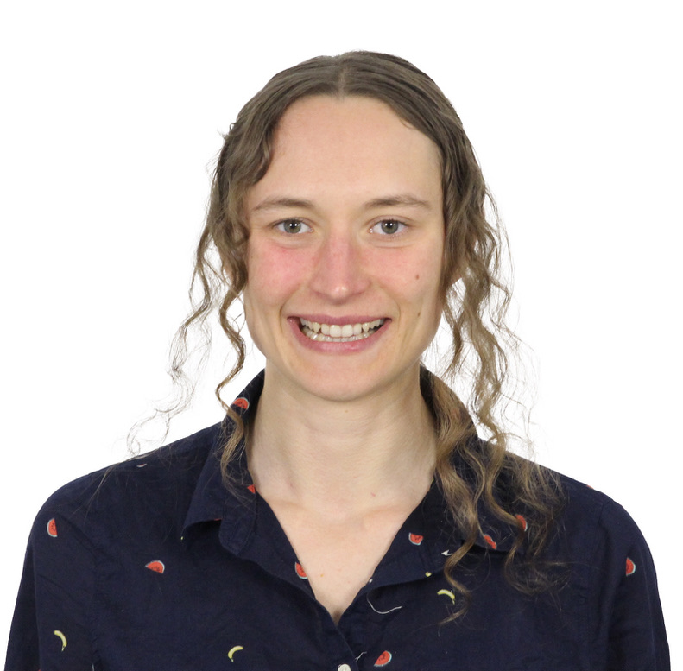







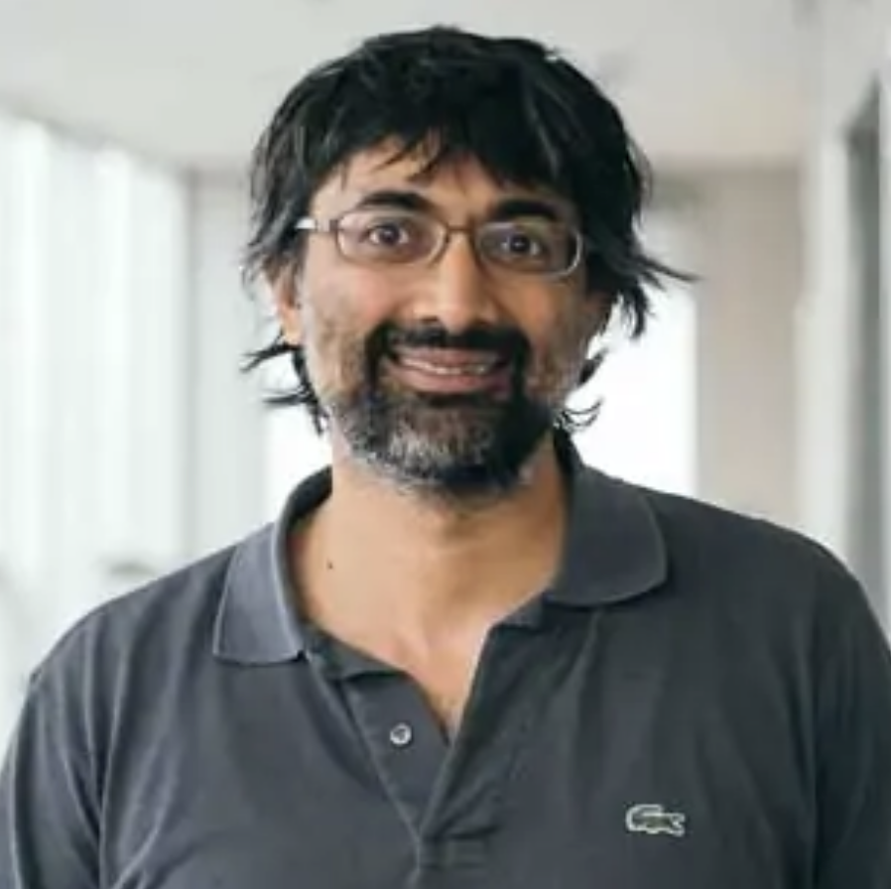


What I We Did
Ultra-Short-Term Probabilistic Spatio-Temporal Modeling of Wind Farm Dynamics and Disturbances for Controls
Core Software Dev Team
Contributors
External Advisors
Preprocessing
Model Implementation
Accuracy & Coverage Validation
Forecast-Enabled Yaw Control Validation
Hyperparameter Tuning
Training
Notes:
But I didn’t have to do it alone. Over the course of this PhD I have developed the skill of roping people in.

Slide 26
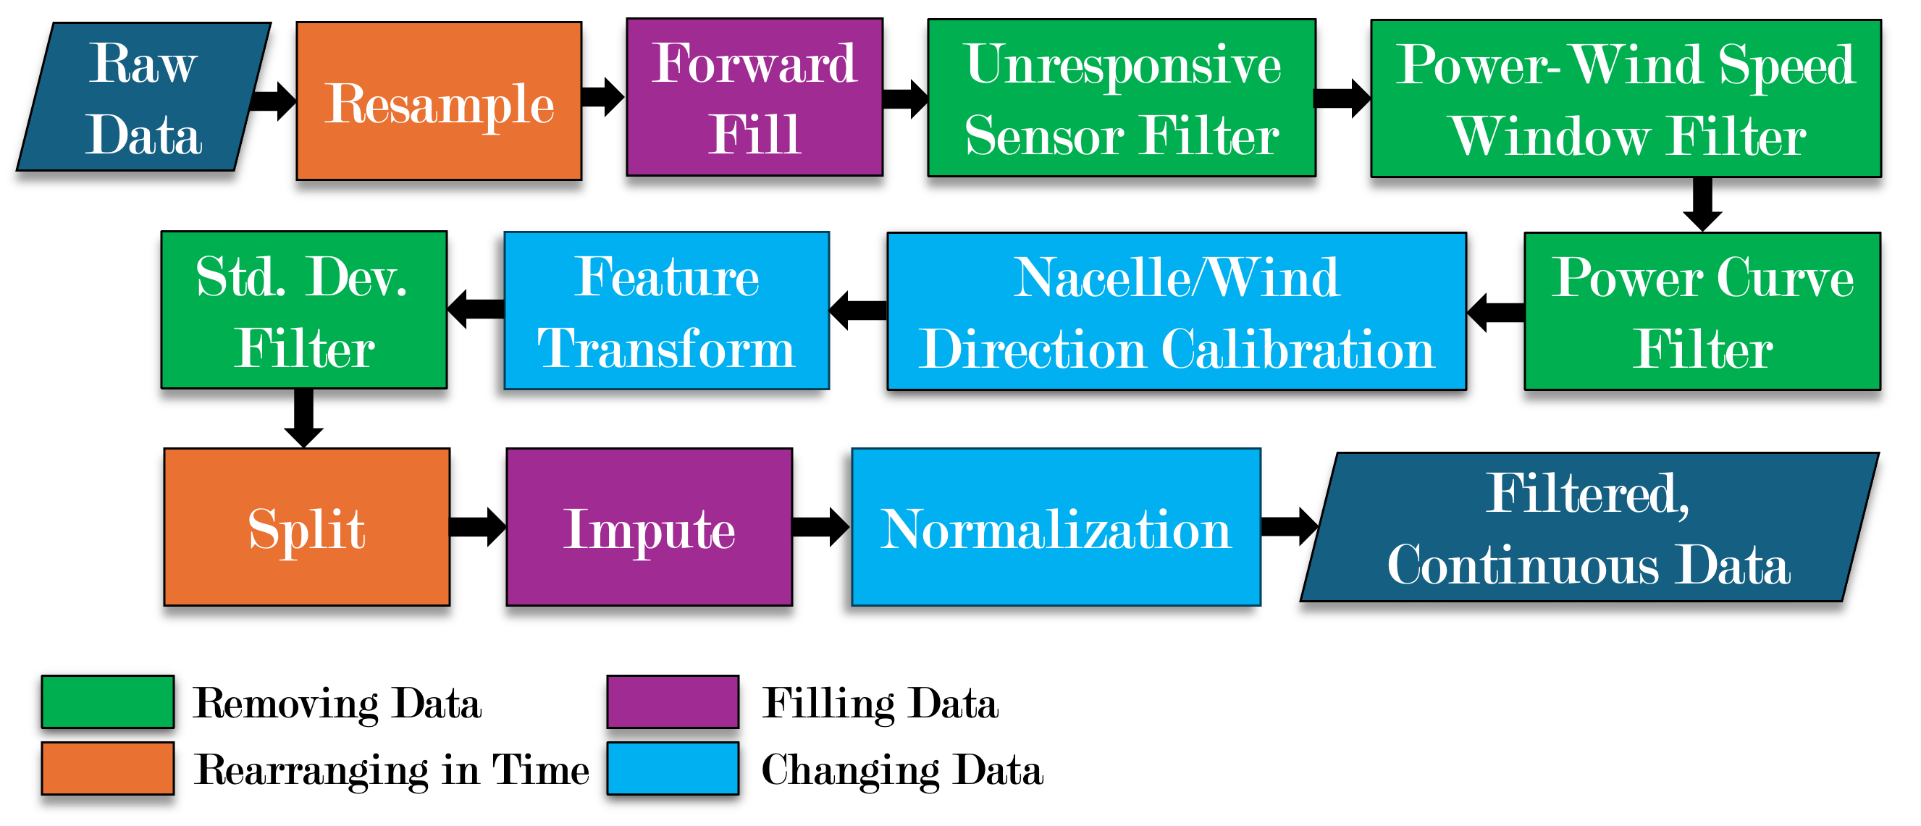
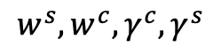
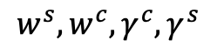
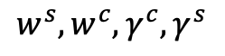
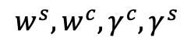
Preprocessing SCADA Data
$$w^{s},w^{c}, γ^{c}, γ^{s}$$
$$w^{s},w^{c}, γ^{c}, γ^{s}$$
$$w^{s},w^{c}, γ^{c}, γ^{s}$$
$$w^{s},w^{c}, γ^{c}, γ^{s}$$
Training
V
Ts
Preprocessing
Model Implementation
Accuracy & Coverage Validation
Forecast-Enabled Yaw Control Validation
Hyperparameter Tuning
Training
Notes:
Step 1 was preprocessing. I was fortunate to have access to 28 months of 1Hz data from the operational King Plains wind farm in Oklahoma – 88 turbines of 2.8MW each. I think that this is a piece that is missing from many publications on forecasting rooted in CS – getting the data to a state where you can learn true relationships without the noise

Slide 27


Preprocessing SCADA Data
Power Curve Filter
Feature Transform
Preprocessing
Model Implementation
Accuracy & Coverage Validation
Forecast-Enabled Yaw Control Validation
Hyperparameter Tuning
Training
Notes:
I would be happy to get in the trenches of data preprocessing later, but for now here are some highlights – on the left we have the power curve filtering, where we exclude outliers that are an excessive deviation below the estimated power curve. In the interest of retaining as much information as possible, we didn’t exclude values above, which correspond to derated conditions, bc while the wind speed is affected by derating, we still consider it a valid measurement.
On the right we have the feature transform necessary to feed the machine learning models, because they don’t like circular measurements.

Slide 28


Transformer-Based ML Models for Forecasting
Embed the context/prediction sequence into model dimension $d_{m}$
Encode the context sequence and decode the prediction sequence into a fixed dimension $d_{m}$ with different lengths $τ_{c}$, $τ_{p}$
Self-Attention highlights the importance of each variable in sequence in predicting the other variables in the same sequence
Cross-Attention highlights the importance of each variable in an input sequence in predicting the other variables in a different output sequence
Multi-Head Attention applied attention to multiple subsets of $d_{m}$ in parallel
Masked Multi-Head Attention hides the future values from the decoder
Output Layer projects fixed dimension into distribution parameters
Preprocessing
Model Implementation
Accuracy & Coverage Validation
Forecast-Enabled Yaw Control Validation
Hyperparameter Tuning
Training
Notes:
When I approached one of my advisors at NREL, Cong, with my interest in using ML models for time series forecasting, he enlightened me to the fact that recurrent neural networks were out, and Transformers were in. So the ML models I experimented with are all based on this general architecture.

Slide 29

Transformer-Based ML Models Informer
Reduced complexity for long-range forecasting
ProbSparse attention
Self-attention distilling
Attention finds correlations between time-steps, not between different variables
Zhou, Haoyi, et al. "Informer: Beyond efficient transformer for long sequence time-series forecasting." Proceedings of the AAAI conference on artificial intelligence. Vol. 35. No. 12. 2021.
Preprocessing
Model Implementation
Accuracy & Coverage Validation
Forecast-Enabled Yaw Control Validation
Hyperparameter Tuning
Training
Notes:
First, the Informer, it was one of the first transformers for time-series forecasting that addressed the painful O(L^2) sequence length complexity, reducing it to O(Llog(L)).
Explain Probsparse attention
Allowing each key to only attend to the u=c*log(Lq) dominant queries
Top-u queries under the sparsity measurement M(q,K)
only need to calculate O(ln LQ) dot-product for each query-key lookup
measure the “likeness”/sparsity measurement through empirical approximation of the Kullback-Leibler divergence of p(kj | qi) from uniform distribution => high value, more diverse probability
Explain Self-attention distilling
Redundant combinations of value due to ProbSparse
Maxpool(ELU(Conv1d(Attn(X))))

Slide 30

Transformer-Based ML Models Autoformer
Reduced complexity for long-range forecasting
Autocorrelation in place of self-attention weights time-delayed sub-series by their autocorrelation coefficient
Series Decomposition extracts the seasonal (i.e. short-term fluctuations) and the trend-cyclical (i.e. long-term trend) components
Wu, Haixu, et al. "Autoformer: Decomposition transformers with auto-correlation for long-term series forecasting." Advances in neural information processing systems 34 (2021): 22419-22430.
Preprocessing
Model Implementation
Accuracy & Coverage Validation
Forecast-Enabled Yaw Control Validation
Hyperparameter Tuning
Training
Notes:
Second, the Autoformer, it discards the attention modules in favor of auto-correlation and series decomposition, also achieving O(Llog(L)) complexity.
The encoder focuses on the seasonal part modeling. The output of
the encoder contains the past seasonal information and will be used as the cross information to help
the decoder refine prediction results.
The decoder contains two parts: the accumulation structure for trend-cyclical components
and the stacked Auto-Correlation mechanism for seasonal component.
Explain autocorrelation:
Auto-Correlation discovers the period-based dependencies by calculating the series autocorrelation and aggregates similar sub-series by time delay aggregation
Auto-Correlation coefficient = time-delay similarity between {Xt}and its τ lag series {Xt−τ}
choose the most possible k period lengths τ1,···,τk.
Normalize with Softmax
Explain series decomposition:
separate the series into trend-cyclical (long-term) (find via moving average) and seasonal (short-term) (difference between full signal and moving average) parts
can extract the long-term stationary trend from predicted intermediate hidden variables progressively.

Slide 31

Transformer-Based ML Models Spacetimeformer
Attention mechanism finds correlations between time-steps AND between different variables
More parameters as a result, less efficient
Performer attention mechanism
Local attention biased toward each feature’s own time series
Global attention captures correlations between all features and time
Grigsby, Jake, et al. "Long-range transformers for dynamic spatiotemporal forecasting." arXiv preprint arXiv:2109.12218(2021).
Preprocessing
Model Implementation
Accuracy & Coverage Validation
Forecast-Enabled Yaw Control Validation
Hyperparameter Tuning
Training
Notes:
Third, Spacetimeformer, this tries to capture the correlations not just over time, but also over different variables across space, at the significant expense complexity issue. It contains a few hacks to reduce this complexity, the Performer attention complexity is linear with the sequence length, and it introduces this local attention to bias learned correlations for a given variable to its own values over time, but it still has a lot more parameters
Explain Performer:
Performer avoids the QK^T O(L^2) matrix multiplication with a kernel approximation of that dot product..
It uses FAVOR+ (Fast Attention Via Positive Orthogonal Random features) to construct feature maps phi st K(qi,kj) ~ E{phi(qi)^T phi(kj)}, where phi has dim r << d_kq.
Approximate attention as: Attention ≈ phi(Q) * (phi(K)^T * V)

Slide 32

Transformer-Based ML Models TACTiS2
Designed for multivariate, probabilistic forecasting
Simpler training procedure with faster convergence to better solutions compared to original TACTiS
Decomposes the joint predictive distribution into univariate marginal distributions
Two encoders: Marginal CDF, Attention Copula
One decoder: Marginal CDF, Attention Copula
Ashok, Arjun, et al. "Tactis-2: Better, faster, simpler attentional copulas for multivariate time series." arXiv preprint arXiv:2310.01327 (2023).
Preprocessing
Model Implementation
Accuracy & Coverage Validation
Forecast-Enabled Yaw Control Validation
Hyperparameter Tuning
Training
Notes:
Explain:
Encoder 1 and 2 to parametrize the marginal CDFs (Fϕi), and the copula distribution (cϕc), respectively.
decoder estimates the conditional density of missing values with a copula-based estimator: two modules, which are tasked with producing the distributional parameters for (i) the marginal CDFs Fϕi, and (ii) the copula cϕc
TACTiS2 vs TACTiS:
choice of the copula-based density estimator: rather than being permutation-invariant, it is of the proposed two-stage type
different approach to learning nonparametric copulas, one that does not rely on permutations
Definition of a Copula
probabilistic object that allows capturing dependencies between d random variables independently from their respective marginal distributions.
joint cumulative distribution function
Fi(xi) = P(Xi ≤xi) is the univariate marginal CDF of Xi
C: [0,1]d →[0,1], the copula, the CDF of a multivariate distribution on the unit cube with uniform marginals
If all Fi are continuous, then this copula-based decomposition is unique.
Two-Stage Copula
satisfies the mathematical definition of a copula
Stage 1: Learn the marginal parameters, irrespective of multivariate dependencies
Stage 2: Learn the copula parameters, given the optimal marginals

Slide 33










Shallow Learning Model Support Vector Regression (SVR)
Marginal SVs
Decision Boundary
$ε$-SVR maximizes the separation to the nearest training data point that is not within some margin $ε > 0$of the hyperplane parameterized by $\left\langle w, φ(x)\right\rangle + b$.
$$ζ_{n}^{⋆}$$
$$ζ_{n}$$
$$ε$$
$$ε$$
Error SVs
$$j$$
$$i$$
$$\{w_{i,0:t_{0}}^{s},w_{j,0:t_{0}}^{s},w_{k,0:t_{0}}^{s},w_{l,0:t_{0}}^{s}\}→SV_{i}^{s}→{{\hat{w}}^{s}}_{i, t_{0}+τ_{p}}$$
$$l$$
$$\{w_{i,0:t_{0}}^{c},w_{j,0:t_{0}}^{c},w_{k,0:t_{0}}^{c},w_{l,0:t_{0}}^{c}\}→SV_{i}^{c}→{{\hat{w}}^{c}}_{i, t_{0}+τ_{p}}$$
$$k$$
Preprocessing
Model Implementation
Accuracy & Coverage Validation
Forecast-Enabled Yaw Control Validation
Hyperparameter Tuning
Training
Notes:
I wanted to implement some reasonable benchmarks to compare these deep learning models to. The first one being the support vector regressor, which I had seen used for wind speed forecasting in the literature. And I guarantee you, I didn’t try to diminish its performance - there’s no deceit in this SVR – I tuned its hyperparameters using the same framework as I did for the ML models, and trained it on the full training dataset too.
For regression I used epsilon-SVR, which … by solving this optimization problem. I implemented two SVRs for each turbine, for the u and v components, and the inputs it would consider came from the history of a cluster of neighboring turbines.

Slide 34







Estimator Model Kalman Filter
$$j$$
$$i$$
Prediction Step – predict mean/covariance based on model:
$$l$$
$$k$$
$${\{w}_{ijkl,0:t_{0}}^{s},w_{ijkl,0:t_{0}}^{c}\}→KF→\{{{\hat{w}}^{s}}_{ijkl, t_{0}+τ_{p}},{{\hat{w}}^{c}}_{ijkl, t_{0}+τ_{p}}\}$$
Update Step - incorporate feedback from measurements:
Preprocessing
Model Implementation
Accuracy & Coverage Validation
Forecast-Enabled Yaw Control Validation
Hyperparameter Tuning
Training
Notes:
My second benchmark was the Kalman Filter. I implemented one to capture the u and v components of the wind speed at all turbines, in the hope that it would learn from correlations between them.
QUESTION LUCY is this possible with a diagonal covariance matrix??

Slide 35








Statistical Model Spatial Filtering
For each turbine $i$, consider cluster of neighboring turbines $\{i,j,k,l\}$.
Get point $c$ upstream based on prediction time and wind speed at $i$.
Compute weighted sum of wind speed components, where weights $α$ are computed from a Gaussian distribution with mean $c$ and standard deviation of distances of turbines from $c$.
$$j$$
$$τ_{p}|w_{i}|$$
$$i$$
$$c$$
$$l$$
$$k$$
$${\hat{w}}_{i,t_{0}+τ_{p}}=α_{i,i}w_{i, t_{0}}+α_{i,j}w_{j, t_{0}}+α_{i,k}w_{k, t_{0}}+ α_{i,l}w_{l, t_{0}}$$
$${\hat{w}}_{c}=α_{i}w_{i}+α_{j}w_{j}+α_{k}w_{k}+ α_{l}w_{l}$$
Sinner, Michael, et al. "Power increases using wind direction spatial filtering for wind farm control: Evaluation using FLORIS, modified for dynamic settings." Journal of Renewable and Sustainable Energy 13.2 (2021).
Preprocessing
Model Implementation
Accuracy & Coverage Validation
Forecast-Enabled Yaw Control Validation
Hyperparameter Tuning
Training
Notes:
Finally, I adapted a method of Misha’s and Eric’s, spatial filtering, to estimate the wind field at a point upstream of each turbine as the weighted average over a cluster of neighboring turbines.

Slide 36


Hyperparameter Tuning with Optuna
Tree-Structured Parzen Estimator (TPE) sampler to choose which hyperparameters to test for each trial
Hyperband pruning discards poorly-performing hyperparameters while continuing to evaluate well-performing ones by varying both the number of configurations explored, and the training resources provided to each trial (number of steps/epochs trained)
Set up on 2 x HPC systems with dedicated servers to run many trials in parallel
Parameters to tune: $d_{m}, N_{enc}, N_{dec}, H, B, τ_{c}$ for ML models; $C, γ, ε$ for SVRs.
Li, Lisha, et al. "Hyperband: A novel bandit-based approach to hyperparameter optimization." Journal of Machine Learning Research 18.185 (2018): 1-52.
Watanabe, Shuhei. "Tree-structured parzen estimator: Understanding its algorithm components and their roles for better empirical performance." arXiv preprint arXiv:2304.11127(2023).
Akiba, Takuya, et al. "Optuna: A next-generation hyperparameter optimization framework." Proceedings of the 25th ACM SIGKDD international conference on knowledge discovery & data mining. 2019.
Preprocessing
Model Implementation
Accuracy & Coverage Validation
Forecast-Enabled Yaw Control Validation
Hyperparameter Tuning
Training
Notes:
It is well-established at this point that the hyperparameter choice for a machine learning model can have a significant impact on its performance, so we, Juan in particular, installed the Optuna framework for automatically tuning these parameters. …
I actually worked quite closely with research computing team here at CU on a Beta program to test there new GPUs using my workflows..
TODO:
How is hyperparameter importance quantified?

Slide 37


Hyperparameter Tuning with Optuna
Preprocessing
Model Implementation
Accuracy & Coverage Validation
Forecast-Enabled Yaw Control Validation
Hyperparameter Tuning
Training
Notes:
On the left you can see how the objective value (weighed quantile loss) decreases over each hyperparameter “trial”. On the right you can see how long each of these trials were run for, and how the fourth one was ‘pruned’ for not delivering the goods.
explain Weighted quantile loss:
Normalized by absolute sum of values, max(alpha * (x - x_alpha), (1-alpha) * (x_alpha – x))

Slide 38

Grid Search for Best Prediction Horizon
Preprocessing
Model Implementation
Accuracy & Coverage Validation
Forecast-Enabled Yaw Control Validation
Hyperparameter Tuning
Training
Notes:
When it came time to generate this plot, we don’t need to talk about how recently that was, although Juan and I and no less than 3 supercomputers between us, all three decided to shut down at the same time - one was overloaded, one overheated, and then Kestrel…was just being Kestrel. Weren’t many others working at 9pm so I notified them.

Slide 39


Training ML Models
4 x A100 GPUs on Kestrel system, with occasional H100s on RC
1000 batches ($B$), 100 epochs
To minimize negative log likelihood function
… for Low-Rank Multivariate Normal Distribution
$$\min_{w,b}\left[\frac{1}{2Bτ_{p}}\sum_{x∈𝒟_{B}}{\sum_{t∈[1,τ_{p}]}{\log{ \text{Pr}\left(x_{t} | μ_{t}, D_{t}, L_{t}\right)}}}\right]$$
$$Σ_{t}=D_{t}+L_{t}⋅L_{t}^{T}, L∈ℝ^{2\left|𝒯\right|×r}, r≪2\left|𝒯\right|$$
Preprocessing
Model Implementation
Accuracy & Coverage Validation
Forecast-Enabled Yaw Control Validation
Hyperparameter Tuning
Training
Notes:
Once we had the best hyperparameter configuration for each model, we trained each model for a longer time using those hyperparameters, with the objective of minimizing the negative log likelihood function, where the output of the models is this low rank multivariate normal distribution. Why low-rank, because I had a deadline to graduate and did not have time to wait for those O(n^2) covariance inversions.
Explain:
Equivalence of MSE and minimizing NLL
Bayesian approach to curve fitting
Num_vars * ln(2pi) + log_dt + M
+
Log_det ~ ln|cov_t|
+
M ~ (x_t – mu_t)’ cov_t^-1 (x_t - \mu_t)
Inverting covariance matrix is O(n^2)
Teacher forcing, one-shot decoder output during training
Sequential decoder output during testing

Slide 40





Sharpness & Reliability of Probabilistic Models
Deterministic metrics
RMSE
MAE
Probabilistic metrics
Prediction Interval Coverage Probability (PICP)
Prediction Interval Normalized Average Width (PINAW)
Coverage Width Criterion (CWC)
Continuous Ranked Probability Score (CRPS)
Preprocessing
Model Implementation
Accuracy & Coverage Validation
Forecast-Enabled Yaw Control Validation
Hyperparameter Tuning
Training
Notes:
You’re about to see a bunch of formulas, so to the non-engineers in the room, you may want to shield your eyes.
In addition to RMSE and MAE…

Slide 41
Accuracy & Coverage of Probabilistic Models
RESULTS
Preprocessing
Model Implementation
Accuracy & Coverage Validation
Forecast-Enabled Yaw Control Validation
Hyperparameter Tuning
Training

Slide 42


Forecast-Enabled Yaw Control
(Locally) Greedy Control
(Locally) Greedy/Consensus Control (toggle every 30 min)
(Locally) Greedy/LUT Control (toggle every 60 min)
Spatiotemporal Transformer
Autoformer (2021)
Informer (2021)
Spacetimeformer (2021)
STTRE (2023)
Uncertainty Layer
Predict Probability Distribution Parameters
Weight Uncertainty
Predict quantiles
Photo Credit: Eric Simley
Notes:
This is the King Plains wind project located in Garber County, Oklahoma, which is part of the AWAKEN dataset. It’s a 250MW farm consisting of 88x2.82MW GE turbines. Since the wind direction is predominantly southerly, this is the wind rose on the bottom left, we would expect the wind at these downstream turbines to generally be impacted most by the wake effect.
I want to bring your attention to 3 turbines in particular: The first [click], is operated on greedy control. I’ve selected the wind speed and direction at this turbine to be the target variables for our model trained on greedy-control operated turbines. The second and third [click], are operated on greedy and lookup table control, toggled every 60 minutes, and these will be our target variable turbines when we train the model on LUT-operated turbines.
Now, I want to talk about augmenting benchmark wind farm controllers with a forecasted preview of the wind field, and how we will validate that.

Slide 43




Forecast-Enabled (Locally) Greedy Yaw Control
(Locally) Greedy Control
(Locally) Greedy/Consensus Control (toggle every 30 min)
(Locally) Greedy/LUT Control (toggle every 60 min)
Established Greedy Control
The commanded yaw setpoint is based on real-time wind direction measurements:
Spatiotemporal Transformer
Autoformer (2021)
Informer (2021)
Spacetimeformer (2021)
STTRE (2023)
$$γ_{i}^{com}\left(t\right) \sim DB\left(LPF\left(∠w_{i}\left(0:t_{0}\right)\right)\right)$$
… such that the actual yaw angle is based on delayed wind direction measurements:
$$γ_{i}^{meas}\left(t\right) \sim f\left(∠w_{i}\left(0:t_{0}−τ_{d}\right)\right)$$
Forecast-Enabled Greedy Control
The commanded yaw setpoint is based on forecasted wind direction:
Uncertainty Layer
Predict Probability Distribution Parameters
Weight Uncertainty
Predict quantiles
$$γ_{i}^{com}\left(t\right) \sim DB\left(LPF\left(∠{\hat{w}}_{i}\left(0:t_{0}+τ_{d}\right)\right)\right)$$
… such that the actual yaw angle is based on real-time wind direction measurements:
$$γ_{i}^{meas}\left(t\right) \sim f\left(∠w_{i}\left(0:t_{0}\right)\right)$$
Notes:
This is our token greedy-controlled target turbine. I’ll summarize first how the established greedy controller works [click]. The commanded …, and so the actual …
In contrast, if some industrious PhD and Masters students were to make a forecast-enabled greedy controller, [click] then the commanded …, such that the actual …

Slide 44
Forecast-Enabled (Locally) Greedy Yaw Control
RESULTS
Preprocessing
Model Implementation
Accuracy & Coverage Validation
Forecast-Enabled Yaw Control Validation
Hyperparameter Tuning
Training

Slide 45

Forecast-Enabled LUT Yaw Control
(Locally) Greedy Control
(Locally) Greedy/Consensus Control (toggle every 30 min)
(Locally) Greedy/LUT Control (toggle every 60 min)
Established LUT/Wake Steering Control
The commanded yaw setpoint is based on real-time wind speed/direction measurements:
Spatiotemporal Transformer
Autoformer (2021)
Informer (2021)
Spacetimeformer (2021)
STTRE (2023)
$$γ_{i}^{com}\left(t\right) \sim LUT\left(DB\left(LPF\left(\left|w_{i}\right|\left(0:t_{0}\right),∠w_{i}\left(0:t_{0}\right)\right)\right)\right)$$
… such that the actual yaw angle is based on delayed wind speed/direction measurements:
$$γ_{i}^{meas}\left(t\right) \sim f\left(\left|w_{i}\right|\left(0:t_{0}−τ_{d}\right),∠w_{i}\left(0:t_{0}−τ_{d}\right)\right)$$
Forecast-Enabled LUT/Wake Steering Control
The commanded yaw setpoint is based on forecasted wind speed/direction:
Uncertainty Layer
Predict Probability Distribution Parameters
Weight Uncertainty
Predict quantiles
$$γ_{i}^{com}\left(t\right) \sim LUT\left(DB\left(LPF\left(\left|{\hat{w}}_{i}\right|\left(0:t_{0}+τ_{d}\right), ∠{\hat{w}}_{i}\left(0:t_{0}+τ_{d}\right)\right)\right)\right)$$
… such that the actual yaw angle is based on real-time wind speed/direction measurements:
$$γ_{i}^{meas}\left(t\right) \sim f\left(\left|w_{i}\right|\left(0:t_{0}\right),∠w_{i}\left(0:t_{0}\right)\right)$$
Notes:
Similarly this is our triplet of LUT-controlled target turbines. The established LUT controller [click] works by passing low-pass-filtered wind speed and direction measurements to a lookup table to fetch the optimized yaw setpoints. Now the commanded …, and so the actual …
In contrast, in the case of a forecast-enabled LUT controller, [click] the commanded …, such that the actual …

Slide 46
Forecast-Enabled Static-Optimal LUT Yaw Control
RESULTS
Preprocessing
Model Implementation
Accuracy & Coverage Validation
Forecast-Enabled Yaw Control Validation
Hyperparameter Tuning
Training

Slide 47

Forecast-Enabled Dynamic-Optimal LUT Yaw Control
Notes:
To investigate the use of probabilistic forecasting methods, we needed a stochastic control method. So on Eric’s advice, I adapted code from FLORIS to generate a lookup table that optimized the yaw offsets for the wind speed, wind direction, and wind direction standard deviation, and you can see the optimal yaw offsets here for the pair of turbines chosen

Slide 48
Forecast-Enabled Dynamic-Optimal LUT Yaw Control
RESULTS
Preprocessing
Model Implementation
Accuracy & Coverage Validation
Forecast-Enabled Yaw Control Validation
Hyperparameter Tuning
Training

Slide 49
Outline
Motivation for my research
developing the components of a “dream” ML-augmented wind farm controller ...
that are implementable in practice …
and professionally coded as open-source software.
Research completed
statistical and machine learning algorithms
… for turbine-level multivariate multistep probabilistic wind speed/direction forecasting
… integrated with greedy and lookup table control
Future outlook
realizing the full potential of established methods of wind farm control with ML
closing the gap between wind farm control in research and in industry
Notes:
And with that, I want to briefly touch on my less-technical thoughts for the future of research in wind farm control, inspired by my experience with the startup and deep tech commercialization community at CU and beyond.

Slide 50
Future outlook
Realizing the full potential of established methods of wind farm control with ML
“The controller must be backward compatible - we’re not going to turn decades of control engineering upside down for a new framework”.
Control Engineer A @ Siemens Gamesa
“You know what you researchers can do? Put a bunch of LIDARs out there and tell us what the f**k is going on!”
Wind Turbine Project Director @ Copenhagen Offshore Partners
“The performance of our wake steering controller is wildly inconsistent across different sites”.
Control Engineer B @ Siemens Gamesa
“Wake steering comes up a lot with customers. It’s something that isn’t really proven yet in a test scenario. At best, the (power) increase of 1%, (but the) uncertainty is higher than 1%. The biggest hurdle is proving it and making a commercial agreement that the customer wants.
Product Line Leader @ GE Vernova
“We want to know how to combine identification of gusts and incoming weather features into a model that predicts their evolution”.
R&D Engineer @ Vaisala
“We try really hard to squeeze out 0.1% of AEP (gain) from a turbine. But over the full supply chain, if you have a delay of 1 day, or if something is installed incorrectly… what you have spent three months trying to tune is nothing.”
Lead Control Engineer @ Siemens Gamesa
“No matter how many times we tune the (farm power prediction model), the result is always 5% off.”
Senior Performance Engineer @ Glennmont Partners
Notes:
I completed two intensive customer discovery programs run by the NSF last year – the first was 3 weeks long with 10 interviews, the seconds was 6 weeks and required 30 interviews. The motive for this, both for the organizers and myself, was to get out of the lab and learn from the people on the front line in industry what the true industry needs are. This is a sampling of what I was told. I got an informal award at the CU i-Corps programs for the most dense notetaking during interviews, and you can see why. The typing lessons finally paid off.

Slide 51




Future outlook
Closing the gap between wind farm control in research and in industry
Environment-aware control
site-specific modeling and optimization
Disturbance-aware control
incoming wind conditions
power demand signals
electricity prices
Flexible and cooperative
energy storage systems
power tracking
Focus on the industry’s greatest “pain points”
component lifetime
curtailment
reliable, fast modeling
Notes:
So my takeaways from these conversations is that, as researchers, we need to address the true ‘project-killers’ in the wind industry, or at least those we can influence. Some areas with problems I am interested in include… and I do in fact intent to pursue a problem in one of these areas at Stanford starting June 30th , I’m teamed up with Rafa, who Eric and Misha both work closely with and I reached out to when I learned he was going part time to start a company, my Stanford mentor Gianluca Iaccario, and an advisor in Alan Lowden, who has a strong history of business in the wind industry in the UK.

Slide 52









Acknowledgements
Lucy Pao
CU Boulder
Advisor
Misha Sinner
NREL
Advisor
Eric Simley
NREL
Advisor
Cong Feng
NREL
Advisor
Emily Jensen
Committee Member
CU Boulder
Jennifer King
NREL
Advisor
Manuel Pusch
Munich University
of App. Sciences
Advisor
Joewie Koh
CU Boulder
Advisor
Alessandro Roncone
CU Boulder
Made RL cool
Marco Nicotra
CU Boulder
Made MPC cool
Emiliano Dall’Anese
Boston University
Convinced (and funded) me to move to CO during a pandemic
Notes:
My committee here today is far from a random selection, you are all people that have supported and advised me even before I started at CU formally. I learned early on in grad school that collaboration was key to progressing in research that interested me, and also to make it more enjoyable, and I have been lucky enough to work with many people to various degrees. They include [click] * 11. (in typical CS fashion, when I approached Alessandro saying, hey I have this idea for a paper, within 5 minutes of the meeting he suggested we spin-off into a startup).
Emiliano also introduced me to online learning methods and MPC, so I'm grateful for that opportunity too.

Slide 53








Steven Thelosen
Eindhoven University of Technology
Collaborator
Juan Manuel
Boullosa Novo
University of Oldenburg
Collaborator
Dano Marshall, Erica Fagan, Emily Vogt, Joshua Bennett, Wil Srubar, Susan Strong
CU Boulder
Innovation Corps™️, Venture Partners, Ascent Deep Tech Accelerator
ians
David Salinas, Kashif Rasul, Azad Deihim, Vincent Zheng
Global
Machine Learning Researchers
Hailey Herman
CU Boulder
3MTⓇ Competition

Slide 54



Curiosities, critiques, suggestions?*
*unconditional acclaim also welcome
Notes:
That is all from me, I can now take any questions.
Possible questions:
- How can you do preprocessing in real time?
How will you know how much of a forecasting lead time you need to augment the greedy/lut controller with a preview?
Delay time, t_d. What we will do instead is generate a multistep forecast and then try sampling from this a range of prediction times until we find the one that results in the greatest overall power improvement. The delay from measured wind direction to final yaw setpoint for greedy and LUT control has three sources: thresholding, slow yaw rate, and use of previous measurements rather than forecasted or preview, and is nonlinear, so not trivial to say a priori what delay time is needed. They don’t have an effective constant sampling rate, in which case we could approximate the upstream time needed before a yaw change would be made.
What about forecasting methods more easily trained online or less data intensive e.g. Kalman filtering, ARIMA, Gaussian processes?
univariate, requires intuitive data preprocessing, formation of candidate functions, tends to be used for longer time scales. ARIMA assumes relationship between future values and previous are approx. linear. KF can be multivariate, but the matrices involved become very large for many variables, and its assumption of Gaussian noise can be problematic.
What do you know about the convergence properties of the MPC?
I don’t. I’ve tested three solver variations: SLSQP, sequential SLSQP, and Serial Refine. We have a non-convex black-box term in our cost function. I warm start it with the LUT solution, and then the SLSQP-based solvers iterate from that to make it feasible over a prediction horizon, and to consider the cost of the yaw actuation. I’ve run several thousand simulations and haven’t had a problem with convergence yet, so I have only empirical evidence to stand by. The main focus of this paper was the application of a controller in a computationally feasible way in an open-source framework, validated by simulated experiments.
Explain SLSQP
Sequentially solve approximations of the nonlinear program, quadratic approximations of the cost function and linear approximations of the constraints, reformulated as a Lagrangian to solve an unconstrained problem. The Hessian of the objective function is updated with a BFGS (Broyden–Fletcher–Goldfarb–Shanno) method. Resulting search direction used to update the optimization variables.
Explain sequential SLSQP (slide 73)
I solve the farm in subsets of turbines, starting from the most upstream to the most downstream. For each subset, the powers of all of the turbines in that subset and downstream are considered in the optimization cost, and all of the yaw angles in that subset are considered in the optimization variables.
Explain Serial Refine (slide 74)
optimizes the turbine yaw angles serially from upstream to downstream by iteratively setting the yaw setpoints of each turbine based on a finite set of values centered on the most recent optimal, determining whether the new combination results in a greater farm power production than the last known optimal solution, and updating them accordingly. I adapted this method for a receding horizon context by enabling it to accept an optimization function that considers the yaw actuation, and by adjusting the optimized yaw setpoints to be within the constraints of the slow yaw actuation over the prediction horizon.
Why do you need the uncertainty quantification?
The LUT can be optimized for the expected farm power achievable over an uncertain distribution of wind directions, wind speeds, and even yaw setpoints. The resulting controller is generally more conservative in terms of the offsets it outputs.
What methods will you use for uncertainty quantification? Slide 58
With a Bayesian neural network layer, the weights are treated as random variables with a probability distribution. This method is based on Bayesian inference, where you start by placing a prior distribution on the weights, P(w), then you compute the variational approximation to the posterior distribution, P(w|D) (minimizing the Kullback-Leibler (KL) divergence with the true Bayesian posterior), and find the MAP weights = max_w log P(w|D). The Bayesian layer generates a distribution over possible outputs. An alternative approach is of predicting the parameters of an output distribution and using a probabilistic cost function e.g. truncated Gaussian-based loss function (the maximum likelihood estimation of it).
What methods will you use for autotuning?
Population based training (PBT) is an attractive option. It starts by training many neural networks in parallel with random hyperparameters. It then uses information from the rest of the population to refine the hyperparameters and direct computational resources to models which show promise. As the training of the population of neural networks progresses, this process of exploiting and exploring is performed periodically, ensuring that all the workers in the population have a good base level of performance and also that new hyperparameters are consistently explored.
Did you consider using a zeroth-order gradient estimation method? Slide 77
Yes, we tried one that seemed promising: Zeroth-order Stochastic Conditional Gradient descent, which was designed for non-convex black-box cost functions perturbed by some disturbance.
What is the difference between statistical learning and machine learning?
SL: Focuses on understanding the underlying relationships between variables. Emphasizes inference and hypothesis testing to draw conclusions about data. Involves simpler models that are interpretable and come with theoretical guarantees (e.g., significance tests, confidence intervals). Assumes that data follows a specific distribution (e.g., normal distribution).
ML: Focuses on prediction and decision-making. Emphasizes optimizing performance metrics like accuracy, precision, or recall. Often prioritizes model performance over interpretability. Can use very complex models like deep learning networks with many parameters. Often makes fewer assumptions about the underlying data distribution (non-parametric methods). Universal approximator
Aren’t you using steady-state models in your MPC solver? How is that better than a LUT approach?
Firstly, because MPC considers the cost of the actuation over a prediction horizon, it ensures the feasibility of a yawing trajectory over the prediction horizon for an estimate of the future wind disturbance,
Secondly, because the forecast-enabled MPC I would like to develop if I continue to work in this field would have a learned model of the future wind speeds and directions seen at each turbine.
Thirdly, models that include dynamics aren't validated anyway. Wake models = statistical wake locations over time. Not clear that propagating downstream is physically any better than static model. No lightweight dynamic model for use in controls.
Fourthly, In the van der Broek paper there was an issue at end of prediction horizon, steady-state model avoids that by assuming that wakes are everywhere all at once. Dynamic model favored greedy control because it didn't see benefit beyond prediction horizon. Would need long prediction horizon, esp for downstream turbines, may not converge.
If you’re only considering a subset of turbines for the output variables, what do you consider as the input variables?
We plan to use the Maximal Information Coefficient to learn which turbine measurements contribute the most to the output variables at our target turbines over the dataset we have. Seeing as the prevailing wind direction is southerly, most of the relevant input variables will be from upstream turbines in the southerly direction.
If, as you say, greedy and LUT control are lacking, why use them for validation?
We are very fortunate to have real, 5-second-interval data at our disposal. Over the course of the King Plains wind farm campaign, the turbines have been operated on standard greedy control, consensus control, and lookup control, so we want to see if you can use a forecast to squeeze more out of these more established methods, and it also so happens that these are the methods used in the data we have.
Are you just applying existing ML methods, or are you making a new one?
We are starting with well-established methods, but would like to bolster them with uncertainty quantification, multi-step outputs, perhaps a series decomposition layer, and the option to consider correlations between the same variable types across multiple time steps and spatial locations.
What’s involved in the data preprocessing? Slide 59
Outliers (to remove or interpolate), offline turbines, missing data, bad data (negative power/wind speed values).
What exactly is a transformer-based neural network? Slide 57
Deep learning architecture that can take sequential data as an input and output sequential data of a possible different length as an output. This is called a seq2seq, or encoder-decoder architecture in the business. What is special about transformers, the term was originally coined by the paper by Vaswani in 2017, is the attention mechanism.
1) Self-attention allows the model to weigh the importance of different tokens relative to one another, irrespective of the distance between them. Each token in the sequence attends to every other to capture temporal or spatial relationships.
2) Cross-attention, allows the decoder focus on different parts of the encoded input sequence when predicting each element of the output sequence
3) Multi-head attention allows the encoded input to be divided across its full dimension, so that he attention mechanism can be applied to multiple sections in parallel,
4) positional encoding is a way of encoding the position of a token in a sequence in a higher dimensional vector,
5) The encoder processes the input sequence and outputs a contextual representation while decoder uses this representation, along with the target sequence, to generate predictions.
What is the difference between the forecasting methods you showed?
Relative embeddings in STTRE - 3 embedding modules for temporal, spatial, and spatiotemporal. Multi-head attention is divided across embedding and temporal dimensions for the temporal module, across embedding and spatial dimensions for the spatial module, and across spatial and temporal for the spatio temporal module. …
Attention across time steps and spatial locations in Spacetimeformer couples absolute position embeddings with variable embeddings, informing the attention mechanism about both position information and variable information of each element, allowing it to capture spatio-temporal dependencies.
Is it realistic to use a neural-network based method in an online setting?
There is a paper (by Dai et al) that did just this quite successfully for wind power predictions, where they pretrained the model, and once it was being used in operation, whenever a prediction exceeded a given error threshold, new data was added and the model retrained. It only needs to be better than persistence!

Slide 55
Journal Paper #2
Motivation for Forecast-Enabled Model-Based Control
LUT wo/ Preview
Notes:
So the good news is that we did actually achieve superior farm power of 0.8% compared to the LUT approach for equivalent yaw activity, and the convergence time was manageable.
The missing link however, is that we need a true forecast of the wind experienced by downstream turbines or the power generated by them to transform this into a complete ML-augmented controller.

Slide 56
Journal Paper #2
Motivation for Forecast-Enabled Model-Based Control
MPC w/ Stochastic Preview (+2.6% Farm Power, +76% Yaw Activity))
Notes:
So the good news is that we did actually achieve superior farm power of 0.8% compared to the LUT approach for equivalent yaw activity, and the convergence time was manageable.
The missing link however, is that we need a true forecast of the wind experienced by downstream turbines or the power generated by them to transform this into a complete ML-augmented controller.

Slide 57
Journal Paper #2
Motivation for Forecast-Enabled Model-Based Control
MPC w/ Perfect Preview (+5.7% Farm Power, +148% Yaw Activity)
Notes:
So the good news is that we did actually achieve superior farm power of 0.8% compared to the LUT approach for equivalent yaw activity, and the convergence time was manageable.
The missing link however, is that we need a true forecast of the wind experienced by downstream turbines or the power generated by them to transform this into a complete ML-augmented controller.

Slide 58

Nacelle/Wind Direction Calibration

Slide 59

Preprocessing SCADA Data
Nacelle/Wind Direction Calibration
Preprocessing
Model Implementation
Accuracy & Coverage Validation
Forecast-Enabled Yaw Control Validation
Hyperparameter Tuning
Training

Slide 60

Preprocessing SCADA Data
Imputing

Slide 61




Transformer-Based ML Models Vanilla Transformer
Vaswani, A. "Attention is all you need." Advances in Neural Information Processing Systems (2017).

Slide 62

Transformer-Based ML Models Informer
Self-attention distilling
Zhou, Haoyi, et al. "Informer: Beyond efficient transformer for long sequence time-series forecasting." Proceedings of the AAAI conference on artificial intelligence. Vol. 35. No. 12. 2021.
Preprocessing
Model Implementation
Accuracy & Coverage Validation
Forecast-Enabled Yaw Control Validation
Hyperparameter Tuning
Training

Slide 63



Transformer-Based ML Models Autoformer
Reduced complexity for long-range forecasting
Autocorrelation in place of self-attention weights time-delayed sub-series by their autocorrelation coefficient
Series Decomposition extracts the seasonal (i.e. short-term fluctuations) and the trend-cyclical (i.e. long-term trend) components
Wu, Haixu, et al. "Autoformer: Decomposition transformers with auto-correlation for long-term series forecasting." Advances in neural information processing systems 34 (2021): 22419-22430.
Preprocessing
Model Implementation
Accuracy & Coverage Validation
Forecast-Enabled Yaw Control Validation
Hyperparameter Tuning
Training
Notes:
Second, the Autoformer, it discards the attention modules in favor of auto-correlation and series decomposition, also achieving O(Llog(L)) complexity.
The encoder focuses on the seasonal part modeling. The output of
the encoder contains the past seasonal information and will be used as the cross information to help
the decoder refine prediction results.
The decoder contains two parts: the accumulation structure for trend-cyclical components
and the stacked Auto-Correlation mechanism for seasonal component.
TODO
Explain autocorrelation:
Auto-Correlation discovers the period-based dependencies by calculating the series autocorrelation and aggregates similar sub-series by time delay aggregation
Auto-Correlation coefficient = time-delay similarity between {Xt}and its τ lag series {Xt−τ}
choose the most possible k period lengths τ1,···,τk.
Explain series decomposition:
separate the series into trend-cyclical (long-term) (find via moving average) and seasonal (short-term) (difference between full signal and moving average) parts
can extract the long-term stationary trend from predicted intermediate hidden variables progressively.

Slide 64

Transformer-Based ML Models TACTiS2
Copula-based density estimators for multivariate time series
Zhou, Haoyi, et al. "Informer: Beyond efficient transformer for long sequence time-series forecasting." Proceedings of the AAAI conference on artificial intelligence. Vol. 35. No. 12. 2021.
Preprocessing
Model Implementation
Accuracy & Coverage Validation
Forecast-Enabled Yaw Control Validation
Hyperparameter Tuning
Training

Slide 65

Transformer-Based ML Models Spacetimeformer

Slide 66



Research completed
Investigation of $ℋ_{∞}$-Tuned Individual Pitch Control for Wind Turbines
“white box” control
ML-augmented control
ML-dominated control
Wind Energy 2024
Notes:
Let’s start with an example of classical control in my work, on the far left side of this spectrum.
This work was on a tuning methodology for individual pitch control of wind turbines to alleviate loads on extreme scale wind turbines using a classical approach known as H-infinity synthesis, while actively mitigating the excessive blade pitch actuation.
I bring this up to say that I did just enough classical control to convince myself that it could benefit from a sprinkle of machine learning…

Slide 67


Research completed
Reinforcement Learning for Firm Power Tracking in Wind Farms
“white box” control
ML-augmented control
ML-dominated control
… forgone for internship
Notes:
I also swung over to the other end of the spectrum.
Myself, a graduate student and professor in CS looked at using reinforcement learning to track a known 24 hour power reference in offshore wind farms with a realistic occurrence of turbines going out of operation.
I opted not to finalize this work into a paper to take an internship instead, but it was just enough reinforcement learning to convince myself that it could benefit from a sprinkle of more traditional control methods.

Slide 68




Research completed
Modeling Blade-Pitch Actuation Power Use in Wind Turbines
“white box” control
ML-augmented control
ML-dominated control
American Control Conference 2023
Notes:
And so the bulk of my research has focused on using machine learning methods in a way that can complement, or “augment”, more established, understandable controls approaches. The first example of this was my first conference paper, which lay somewhere between classical control and ML-augmented control.

Slide 69






Research completed
Modeling Blade-Pitch Actuation Power Use in Wind Turbines
$$β\left(k\right)=f_{β}\left({\hat{u}}_{x}\left(k−1\right)−{\overline{u}}_{x},{\dot{\hat{u}}}_{x}\left(k−1\right)\right)$$
${\hat{u}}_{x}$ Filtered wind speed [m/s]
${\overline{u}}_{x} \text{Mean} \text{wind} \text{speed}$ [m/s]
$β$ Blade pitch control signal [deg]
$$P_{β}\left(k\right)= f_{P}(\dot{β}(k), \ddot{β}(k))$$
$CAPEX$ Capital [kW/$]
$FCR$ Fixed charge rate [%/year]
$OPEX$ Operation/maintenance [$/kW-year]
$AEP$ Annual energy production [kW-year]
$ΔAE_{β}$ Annual blade pitch energy consumption [kW-year]
Henry, Aoife, Manuel Pusch, and Lucy Pao. "Modeling blade-pitch actuation power use in wind turbines." 2023 American Control Conference (ACC). IEEE, 2023.
Notes:
The goal was to model blade-pitch actuation of an operational turbine as a function of the incoming wind speed and rate of change in wind speed…
And then to model the power consumed by the blade pitch actuators as a function of the the derivates of the blade pitch signal.
The overarching purpose of this chain of modeling was to more efficiently estimate the levelized cost of electricity of a turbine, defined here in terms of the capital expenditure, the operation and maintenance costs, and the power generated over a year. LCOE ought to consider the power consumed by blade pitch actuators, which is not insignificant, and we wanted to come up with a concise equation that could estimate this for a given wind field.

Slide 70



Research completed
Modeling Blade-Pitch Actuation Power Use in Wind Turbines
measured next states
modeled next states
$$\text{model} \text{accuracy} \text{vs}\text{. }\text{parsimony}$$
optimized coefficients of candidate functions
candidate functions
auxiliary variable
$$\text{model} \text{accuracy} \text{vs}\text{. }\text{regularity}$$
E. Kaiser, J. N. Kutz, and S. L. Brunton, “Sparse identification of nonlinear dynamics for model predictive control in the low-data limit,” Proc. Royal Society A, vol. 474, no. 2219, p. 20 180 335, 2018.
P. Zheng, T. Askham, S. L. Brunton, J. N. Kutz, and A. Y. Aravkin, “A unified framework for sparse relaxed regularized regression: SR3,” IEEE Access, vol. 7, pp. 1404–1423, 2018.
Notes:
I used a data-driven modeling method known as SINDyC (sparse identification of nonlinear dynamics with control), which is a kind of regularized regression using carefully selected candidate functions constructed from the original variables.
This optimization expression is based on the Sr3 (sparse relaxed regularized regression) approach to solving the problem, and includes...[click] * 7
(C=I is the relaxation matrix, which forces the aux vars to be close to the coefficients, and L=l0 is the regularization function, which penalizes the number of nonzero coefficients.)

Slide 71



Research completed
Modeling Blade-Pitch Actuation Power Use in Wind Turbines
$$β\left(k\right)$$
True
SINDyC-Modeled
$$P_{β}(k)$$
Henry, Aoife, Manuel Pusch, and Lucy Pao. "Modeling blade-pitch actuation power use in wind turbines." 2023 American Control Conference (ACC). IEEE, 2023.
Notes:
The modeling results were pretty good, for both the blade-pitch dynamic function, and for the power use of the blade pitch actuators
This was evidence that you could take a very computationally inexpensive ML method like SINDy, and given enough time spent tuning and choosing the candidate functions, I could produce this plug-and-play model that would be much faster than a simulation for estimating the total energy consumed by actuators over a year for different wind fields
BUT… I did spend a lot of time tuning with different grid search variations, and a lot of brain power trying to come up with candidate functions that could capture the necessary information…

Slide 72

Research completed
Online Learning of Effective Turbine Wind Speed in Wind Farms
Conference on Decision and Control 2023
Notes:
My second conference paper also used “lightweight” machine learning, to learn the effective wind speed at turbine rotors (that is the blades part of the turbine) in a wind farm online, with a method that could be incorporated into MPC.

Slide 73
Research completed
Online Learning of Effective Turbine Wind Speed in Wind Farms
Measurements → Predictions of Wind Speed/Direction at Downstream Turbines
✅ Capture just enough information for control purposes
✅ Train online
Wind Speeds
✅ With uncertainty quantification
Gaussian process regression!
Wind Directions
Magic Wake
Effect Model
Downstream
Turbine
Wind Speeds
Turbine
Control Setpoints
Notes:
I wanted to use a lightweight modeling technique to predict the effective rotor velocity at downstream wind turbines, given measurements of the wind speed and direction, as well as control actions (or the yaw angles) taken by each of the turbines [click * 3]. Gaussian process regression [click] seemed like a strong candidate.

Slide 74





Research completed
Online Learning of Effective Turbine Wind Speed in Wind Farms
Measured outputs, $y$, and predicted outputs, $f_{⋆}$,
… modeled as a joint Gaussian distribution
… parameterized by the measured inputs, $X$,
the prediction inputs, $X_{⋆}$,
and the covariance kernel, $K$.
Predictions with 3 datapoints
Predictions with 11 datapoints
$X$ – training inputs (of wind speeds, wind direction, turbine control actions)
$y$ – noisy measurements (of downstream wind speeds errors)
$X_{⋆}$ – test inputs (of … )
$f_{⋆}$ – test predictions (of …)
$μ[f_{⋆}]$ – GP-predicted mean
$\text{var}[f_{⋆}]$ – GP-predicted variance
$K$ – covariance kernel
GP-predicted mean
GP-predicted variance
Notes:
Gaussian process regression is a modeling approach that assumes that the correlation between outputs can be approximated by the correlation between inputs (i.e. if the inputs are close together, than the outputs are probably close together too), and the prior assumption of zero-mean in the predictions.
[click] You can see from this example of a sine wave how few additional datapoints are required to generate very good predictions
A Gaussian process regressor makes predictions of the mean [click] and variance [click] values for the outputs, mu[f*] and var[f*], for new test inputs, X*.

Slide 75


Research completed
Online Learning of Effective Turbine Wind Speed in Wind Farms
freestream wind directions, turbine wind velocities, turbine control actions
For turbine $d$, time-step $k_{j}$ …
${\tilde{X}}_{d∗}(k_{j})$, measured, normalized freestream wind directions, turbine wind velocities, turbine control actions
$U_{d}^{b}(k_{j})$, ’Base’ model-predicted velocity
$δU_{d∗}(k_{j})$, GP-predicted velocity error
${\hat{U}}_{d}(k_{j})$, Final predicted velocity
‘GP’ model-predicted turbine velocity error
Final predicted turbine velocity
‘base’ model-predicted turbine velocity
Henry, Aoife, et al. "Online Learning of Effective Turbine Wind Speed in Wind Farms." 2023 62nd IEEE Conference on Decision and Control (CDC). IEEE, 2023.
Notes:
This shows the algorithm for predicting the rotor-averaged wind velocity at each downstream wind turbine, at the time-step associated with particular set of measurements, k_j.
[click] We create matrices of normalized autoregressive inputs for each turbine, that’s Xtilde for each turbine 1 through small d and capital D.
[click] Then, we compute what the rotor-averaged wind velocity at the next time step should be according to a ”base” analytical model, that’s Ub for each turbine 1 through small d and capital D.
[click] The normalized autoregressive inputs train a Gaussian process regressor for each turbine, which then output the error between the base model and the true values.
[click] We add that error back to the base model and we get the final predicted turbine rotor-averaged wind velocity.

Slide 76
Research completed
Online Learning of Effective Turbine Wind Speed in Wind Farms
True
Base Model-Predicted
GP-Predicted Mean
GP-Predicted Std. Dev.
Henry, Aoife, et al. "Online Learning of Effective Turbine Wind Speed in Wind Farms." 2023 62nd IEEE Conference on Decision and Control (CDC). IEEE, 2023.
Notes:
This is a time-series results for turbine 7, which should be considerably impacted by the wake effect. The red here is the true measured wind velocity, the blue is the velocity predicted by the base analytical model, the dark green is the GP prediction, and the light green fill is the GP-predicted variance.
This tracking, of the predicted green line to the true red line, was achieved with only 5 data points, each of which were vectors containing the relevant historic measurements.
What makes me skeptical about this approach to wake effect modeling, is that it is only suited for small datasets so it can struggle to learn from long term trends or high-dimensional datasets, and as a result it takes a some time for this method to adjust to changes in the wind.

Slide 77



Research completed
Stochastic MPC with Gaussian Wind Direction Preview for Wake Steering
Outputs
Normalized and transformed turbine power outputs
Control Inputs
% of $Δt_{c}^{\text{MPC}}$ spent Yawing
Cost Function
Linear combinations of squared power outputs and yaw actuation
States
Normalized yaw setpoints
Notes:
Technically speaking, this is an economic MPC problem, because we consider the outputs in the cost function.
Those outputs [click] are the power generated by each turbine at each time-step in the control horizon. We use the Gaussian Curl Hybrid integrated in FLORIS for this output function. (This model represents the velocity deficity as a gaussian distribution in the spanwise direction, and the gaussian profile is controlled by user parameters. There is a near wake zone and a far wake zone. )
The control input [click] for each turbine and each step in the horizon denote the percentage of the control sampling time that the turbine should be yawing, the sign of the control variable gives the direction.… I started this topic trying to tackle a mixed integer problem but thankfully Marco saved me a lot of heartache by suggested that I make all variables continuous if I can, and that proved to be quite an influential piece of advice for the project.
The cost function [click] is the expected value of a linear combination of the control actuation used and the power generated, squared. The parameter alpha tunes the relative importance of each of these two metrics.
The system states [click] that we consider are the yaw setpoints, and the dynamic system equation is limited by the fixed yaw rate.

Slide 78





Research completed
Stochastic MPC with Gaussian Wind Direction Preview for Wake Steering
Conditional multivariate Gaussian distribution
… of horizontal ($u$) and vertical ($v$) wind speeds
… over prediction horizon
Notes:
The focus of this paper is on the controller, and so I assume that I have a stochastic Gaussian preview of the horizontal, u, and vertical, v, wind speed components.
I do this by modeling the value of each component at each time step in some future horizon as a random variable. I construct a mean and covariance matrix that implies a greater correlation between values at closer time steps, and I use the conditional distribution to compute the preview for the next prediction horizon, given the current measured values.
I use this multivariate Gaussian distribution to compute the wind fields used for the simulations as well as for the preview.

Slide 79




Research completed
Stochastic MPC with Gaussian Wind Direction Preview for Wake Steering
”Probabilistic” constraints
$$≥β$$
Notes:
The constraints we care about are those of the yaw offsets – that’s the difference between the yaw setpoint, and the wind direction. These constraints are probabilistic because the wind direction preview is uncertain.
After experimenting with several ways of implementing probabilistic constraints, I landed on the following:
I assume the minimum and maximum likely horizontal/vertical wind speed components I will see are given by a chosen number of standard deviations, (in this case, 2) above and below the expected values over the horizon, given the current measurements. We then impose the constraint that the offset is between plus/minus 30 degrees, considering the extreme wind directions that come from these values.

Slide 80




Research completed
Stochastic MPC with Gaussian Wind Direction Preview for Wake Steering
Derivative of $−\frac{1}{2}α{\left(y_{j}^{\left(i\right)}\right)}^{2}$for “stochastic sample” samples
Derivative of $−\frac{1}{2}α{\left(y_{j}^{\left(i\right)}\right)}^{2}$, scaled quadratic power of turbine $i$ at time-step $j$ for “stochastic sample” samples
$r_{s, j}$ – zero-mean, unity-variance Gaussian
perturbations
$ζ_{j}$ – normalized yaw setpoint
of all turbines at $j$th time-step
$y_{j}^{(a)}$ – transformed power output
of $a$th turbine at $j$th time-step
$α$ – cost function tuning parameter
$η$ – step size
$h$ – FLORIS function to
compute turbine power
Balasubramanian, Krishnakumar, and Saeed Ghadimi. "Zeroth-order (non)-convex stochastic optimization via conditional gradient and gradient updates." Advances in Neural Information Processing Systems 31 (2018).
Notes:
We need to compute the expected gradient value of the cost function to solve our optimal control problem.
To this end I test three different sampling methods for the horizontal/vertical wind speed components at each time step in the preview - in this one, I call "stochastic sampling", I take many samples, say 100-500.
One approach to computing the derivative here is to use the [click] chain rule and then use the [click] zeroth-order stochastic conditional gradient (ZSCG).
I also tested this stochastic sample method with central and forward difference derivatives.

Slide 81




Research completed
Stochastic MPC with Gaussian Wind Direction Preview for Wake Steering
Derivative of $−\frac{1}{2}α{\left(y_{j}^{\left(i\right)}\right)}^{2}$for “stochastic rectangular interval” samples
$ζ_{j}$ – normalized yaw setpoint
of all turbines at $j$th time-step
$y_{j}^{(a)}$ – transformed power output
of $a$th turbine at $j$th time-step
$α$ – cost function tuning parameter
$η$ – step size
$h$ – FLORIS function to
compute turbine power
Notes:
In my second sampling method, called "stochastic rectangular interval sampling", I strategically choose much fewer samples, but spread over the stochastic distribution in a rectangular shape, and I compute the weighted average of the cost function gradient over these samples, where the weights correspond to the probability of obtaining samples of those values.
Again, we can use the [click] chain rule and [click] central difference method to compute derivative, but I also tested this for the forward difference method.

Slide 82

Research completed
Stochastic MPC with Gaussian Wind Direction Preview for Wake Steering
Derivative of $−\frac{1}{2}α{\left(y_{j}^{\left(i\right)}\right)}^{2}$for “stochastic elliptical interval” samples
$ζ_{j}$ – normalized yaw setpoint
of all turbines at $j$th time-step
$y_{j}^{(a)}$ – transformed power output
of $a$th turbine at $j$th time-step
$α$ – cost function tuning parameter
$η$ – step size
$h$ – FLORIS function to
compute turbine power
Notes:
In my third sampling method, based on a suggestion by David after the dry-run of this presentation last month, called "stochastic elliptical interval sampling" I also choose the samples to be spread over the stochastic distribution, but in an elliptical shape rather than a rectangular shape, to avoid the corner-cases.
We can use the [click] chain rule and [click] central difference method to compute derivative, but I also tested this for the forward difference method too as with previous sampling methods.

Slide 83
Tuning
Research completed
Stochastic MPC with Gaussian Wind Direction Preview for Wake Steering
Sampling method - How to sample horizontal/vertical wind speed values over prediction horizon?
Stochastic sample, stochastic rectangular interval, stochastic elliptical interval
Maximum standard deviation – What range around the predicted mean to sample from?
1, 1.5, 2
Sampling method
Differentiation method
Step size
Invalid yaw offset power decay type
Maximum standard derivative for interval sampling and probabilistic constraints
# wind preview samples
Number of wind preview samples – How many samples to take within those bounds?
3 - 500
Differentiation method – How to compute derivative of power term in cost function?
Central vs. forward difference. Chain derivative, $\frac{δ}{δx}\left(−\frac{1}{2}y^{2}\right)≈−y\frac{δy}{δx}$, vs. direct derivative, $\frac{δ}{δx}\left(−\frac{1}{2}y^{2}\right)$
Step size – What step size to use for perturbations in derivative estimate?
0.0001, 0.001, 0.01
Out-of-bounds yaw offset power decay – How to penalize turbine power outputs for out-of-bounds yaw variables during optimization?
No decay, linear decay, cosine decay, exponential decay, zero’d power
Notes:
I spent a lot of time trying to fine-tune this controller and figure out what the most influential parameters were, so I’ll briefly describe some of the key parameters for the MPC optimizer:
First [click] the sampling method, some examples of which you just saw…
Second [click] the maximum standard deviation, that is …
Third [click] the number of wind preview samples …
Fourth [click] the differentiation method, …
Fifth [click], the gradient estimate step size, …
And Sixth [click], the out-of-bounds yaw offset power decay …

Slide 84

Research completed
Stochastic MPC with Gaussian Wind Direction Preview for Wake Steering
Wind Direction
Turbine Yaw Setpoints
Increase in Farm Power
averaged over 6 seeds of 1 hour simulations
+11% vs. Greedy
+0.8% vs. LUT w/ equal yaw activity
Farm Power Output
Turbine Power Outputs
Convergence Time
<20sec for 9 wind turbines
Notes:
So the good news is that we did actually achieve superior farm power of 0.8% compared to the LUT approach for equivalent yaw activity, and the convergence time was manageable.
The missing link however, is that we need a true forecast of the wind experienced by downstream turbines or the power generated by them to transform this into a complete ML-augmented controller.
TODO yaw starts and stops

Slide 85


Extra Slides
Stochastic MPC Tuning
Sampling Type
Differentiation Method
Notes:
I performed grid searches to find the best-performing configurations for each sampling type. This one shows the results for different differentiation methods, central vs forward difference, as well as that zeroth order method I mentioned, or using the chain derivatives for the quadratic term vs just computing the difference between the perturbed and unperturbed cost function terms.
Overall central difference methods seem to perform best.

Slide 86


Extra Slides
Stochastic MPC Tuning
Sampling Type
Step Size
Notes:
These are the results for different step sizes. Smaller is generally better.

Slide 87


Extra Slides
Stochastic MPC Tuning
Sampling Type
Decay Type
Notes:
These are the results for different decay types. We opted to penalize the power output of any turbine that attempts a yaw offset outside of the allowed range for numerical reasons related to FLORIS, and I tested a number of ways to achieve this. It turns out, the solver would rather we didn’t penalize the power outputs at all.

Slide 88


Extra Slides
Stochastic MPC Tuning
Sampling Method
Maximum Standard
Deviation
Notes:
These are the results for the range of standard deviations outside of the mean that I selected samples from, for both the cost function with the stochastic interval methods, and the constraints for all methods. A maximum standard deviation of 1 means that the solver only considers 68% of the wind preview possibilities, or 2 means 95% of the possibilities and thus more coverage and more conservative. The results are mixed for the different sampling types here which is interesting.

Slide 89


Extra Slides
Stochastic MPC Tuning
Sampling Method
# Wind Preview
Samples
Notes:
The same goes for variation in number of samples taken for the wind preview, there isn’t a clear trend in terms of farm power for different number of samples, and in fact a very low number still performs quite well, whereas more samples results in a longer convergence time.

Slide 90



Extra Slides
Research Completed
"Lightweight" machine learning:
1. Modeling Blade-Pitch Actuation Power Use in Wind Turbines (ACC 2023)
2. Online Learning of Effective Turbine Wind Speed in Wind Farms (CDC 2023)
Machine learning-dominated control:
3. Reinforcement Learning (RL) for Firm Power Tracking in Wind Farms
Classical control:
4. Investigation of $ℋ_{∞}$-Tuned Individual Pitch Control (IPC) for Wind Turbines (Wind Energy 2024)
Machine learning-augmented control:
5. Stochastic Model Predictive Control (MPC) with Gaussian Wind Direction Preview for Wake Steering
Notes:
My first paper [click] ... which relates to modeling control laws
My second paper [click] is more closely related to the topic of wind farm wake modeling, and so I show it in bold here...
[click] My third research effort was on ...
[click] My first journal paper was on ...
[click] My most recent, soon to be submitted work is on...
I’ll walk you through each of these individually, but I’ll try to give more attention to the research relevant to learning-augmented wind farm control and give a quick mention to the others.

Slide 91





Extra Slides
Investigation of $ℋ_{∞}$-Tuned Individual Pitch Control for Wind Turbines
Goal: Find a stabilizing full-order controller, $K$, that minimizes:
where:
Henry, Aoife, Manuel Pusch, and Lucy Pao. "Investigation of H∞‐Tuned Individual Pitch Control for Wind Turbines." Wind Energy (2024): e2945.
Notes:
Method
F is the lower linear fractional transformation (LFT) of the generalized plant, P, with the controller, K, that is, the closed-loop transfer function from the disturbances, d, to the performance outputs, z, for a given P and K.

Slide 92



Extra Slides
Investigation of $ℋ_{∞}$-Tuned Individual Pitch Control for Wind Turbines
Large Rotors → Asymmetrical Loads
Wind Shear
Individual Pitch Control !
Tilt
Tuning ?
Yaw
Tower Shadow
Turbulence
Notes:
The problem I was interested in relates to the asymmetrical loads that turbines with extra-large rotors (SUMR, 200m, 50MW) experience. If you think about it, for turbines with a blade radius of 200m, the wind conditions at one blade tip could be very different from the conditions at another blade tip. This asymmetry comes predominantly from wind shear and yaw misalignment, but also turbulence, rotor tilt and the tower shadow effect.
A solution to this is individual pitch control, in which the each blade tracks a distinct blade pitch signal to allow more wind to “pass through” the rotor in regions of high wind, while capturing more wind in regions of low wind, thus evening out the load across the rotor. My focus in this paper was how to structure and tune this controller.

Slide 93

Extra Slides
Investigation of $ℋ_{∞}$-Tuned Individual Pitch Control for Wind Turbines
GOAL:
Tune an individual pitch controller to attenuate asymmetrical loads across extreme-scale turbine rotors …
… that can attenuate loads at 1st and 2nd harmonics of the rotational frequency
→ frequency-domain controller design
… for a wind turbine plant with coupled dynamics
→ multivariable control design
... with robustness to disturbances at the plant input and output
→ robust control design
… without burning the blade-pitch actuators out
→ actuator duty cycle (ADC) attenuation
$⇒ ℋ_{∞}$-Synthesis!
Notes:
Or more specifically…

Slide 94




Extra Slides
Investigation of $ℋ_{∞}$-Tuned Individual Pitch Control for Wind Turbines
1P Loads Attenuated!
2P Loads Attenuated!
ADC Constrained for one Approach
Henry, Aoife, Manuel Pusch, and Lucy Pao. "Investigation of H∞‐Tuned Individual Pitch Control for Wind Turbines." Wind Energy (2024): e2945.
Notes:
Results
And it worked!
This is an example of how, for objectives of particular forms, with a subsystem you can linearize with enough accuracy, that we can squeeze a lot out of a classical controller such as the one presented here. [click]
BUT [click] … we don’t always have a good model, especially when there are more states and control inputs that can’t be neglected involved, and in some scenarios we have more complex, mixed objectives.
If you don’t appreciate the inclusion of gifs and emojis…well then I’ll suppose I’ll have to do this exam again without them, but I hope that’s not the case

Slide 95







Extra Slides
Modeling Blade-Pitch Actuation Power Use in Wind Turbines
a data-driven modeling method …
for identifying the dynamics of nonlinear systems with control inputs …
from measured data …
assuming few dominant terms in the underlying governing equations …
“robustified” with time-series and library ensembling
$X∈ℝ^{n×K}$ matrix of $n$-dimensional states measured at time-steps $[1, K]$
$${X^{+}∈ℝ}^{n×K} \text{matrix} \text{of} n\text{−}\text{dimensional} \text{state}\text{s} \text{measured} \text{at} \text{time}\text{−}\text{steps} \left[2, K+1\right]$$
$U∈ℝ^{m×K}$ matrix of $m$-dimensional control inputs taken at time-steps $[1, K]$
$ζ∈ℝ^{n×N}$ matrix of $N$-dimensional coefficients for each of $n$states being modeled
$Θ(X,U)∈ℝ^{N×K}$ matrix of candidate function values at time-steps $[1, K]$ for each of $N$ terms in model
Notes:
Method
SINDyC is a …

Slide 96

Extra Slides
Modeling Blade-Pitch Actuation Power Use in Wind Turbines
Blade-Pitch Control, $β\left(t\right)$, is a nonlinear function of the incoming wind field, wind turbine specifications and control objectives
→ Blade-Pitch Motor Power, $P_{β}(t)$
→ Mean and Peak Blade-Pitch Motor Power, ${\overline{P}}_{β}, P_{β}^{⋆}$
→ Levelized Cost of Energy estimation
→ Evaluation of wind turbine design
$P_{β}(t)$ is a nonlinear function of the time-derivatives of $β(t)$
PROBLEM
Medium/high-fidelity simulations are SLOW!
SOLUTION
Data-driven models for $β(t)$ and $P_{β}(t)$ that are fast to generate and fast to simulate.

Slide 97



Extra Slides
Modeling Blade-Pitch Actuation Power Use in Wind Turbines
wind field
(+ turbine parameters, control objectives)
$$β\left(t\right)=K_{P}ω_{e}\left(t\right)+K_{I}\int_{0}^{t}{ω_{e}\left(τ\right)dτ}+K_{D}\frac{dω_{e}(t)}{dt}$$
$$β\left(t\right). P_{β}\left(t\right),{\overline{P}}_{β}, P_{β}^{⋆}$$

Slide 98





Extra Slides
Modeling Blade-Pitch Actuation Power Use in Wind Turbines
$$β\left(k\right)=f_{β}\left({\hat{u}}_{x}\left(k−1\right)−{\overline{u}}_{x},{\dot{\hat{u}}}_{x}\left(k−1\right)\right)$$
${\hat{u}}_{x}$ Filtered horizontal wind speed
$${\overline{u}}_{x} \text{Mean} \text{wind} \text{speed}$$
${\dot{\hat{u}}}_{x}$ First time-derivative of ${\hat{u}}_{x}$
$β$ Blade-pitch control signal
$\dot{β}$ First time-derivative of $β$
$\ddot{β}$ Second time-derivative of $β$
$$P_{β}(k)=f_{P}(\dot{β}(k), \ddot{β}(k))$$
approx. $LCOE$
[1] E. Kaiser, J. N. Kutz, and S. L. Brunton, “Sparse identification of nonlinear dynamics for model predictive control in the low-data limit,” Proc. Royal Society A, vol. 474, no. 2219, p. 20 180 335, 2018.

Slide 99







Extra Slides
Online Learning of Effective Turbine Wind Speed in Wind Farms
Maintain evolving training dataset that tends to explore regions of high uncertainty
get new measurements (wind speeds/directions, control setpoints)
New Measurements
add $q$datapoints from regions of high uncertainty from $ℛ_{d}$ to $𝒯_{d}$
add $q$ new datapoints to $ℛ_{d}$
Autoregressive Inputs
$ℛ_{d}$ Replay Buffer
$𝒯_{d}$ Training Dataset
$${𝒢𝒫}_{d}$$
randomly subtract $q$ training datapoints from $𝒯_{d}$ to $ℛ_{d}$
fit the GP with $𝒯_{d}$

Slide 100



Extra Slides
Stochastic MPC with Gaussian Wind Direction Preview for Wake Steering
Notes:
Method – stochastic modeling of preview

Slide 101


Extra Slides
Stochastic MPC with Gaussian Wind Direction Preview for Wake Steering
“Stochastic sample” expected cost
“Stochastic interval” expected cost
Notes:
Method – gradient computation
The control input portion of the cost function is deterministic and trivial to compute, it’s the power part that’s tricker. This is what computing the cost for each of these sampling variations looks like
For the stochastic sample variant, I use a method called Zeroth Order Stochastic Gradient descent to compute the gradient in a computationally efficient way, and for the stochastic interval method, I use a central difference method, but in the code I vectorize the life out of it to make it as efficient as possible.

Slide 102

Extra Slides Sequential SLSQP

Slide 103


Extra Slides Serial Refine
Fleming, Paul A., et al. "Serial-refine method for fast wake-steering yaw optimization." Journal of Physics: Conference Series. Vol. 2265. No. 3. IOP Publishing, 2022.

Slide 104

Extra Slides
Zeroth-Order Stochastic Gradient Method

Slide 105








Extra Slides
Power Decay
Exponential decay
Cosine decay
Linear decay
Zero decay

Slide 106

Extra Slides
Forecasting Wind Speeds
Time-Series Forecasting Problem #1:
by the time yaw setpoints have been updated by the LUT …
the wind direction has already changed
Physical models (Numerical Weather Prediction)
Preview measurements
Statistical models (Persistence, SVMs, ARIMA, f-ARIMA, Kalman filtering, interpolation)
Deep learning models (ANNs, RNN/LSTMs, Transformers)
Hybrid models (statistical/machine learning modules, data preprocessing, parameter optimization)
Grigsby, Jake, et al. "Long-range transformers for dynamic spatiotemporal forecasting." arXiv preprint arXiv:2109.12218(2021).
Notes:
This is by no means a new problem, and so there are a number of published approaches to solving it:
There are physical models – we can use weather forecast data and geographical environment information to establish mathematical equations and makes predictions by describing the physical process of wind evolution. However, physical modeling has high complexity and requires a large amount of detailed information. It is suitable only for longer-term prediction (hours to days), and its application in short-term prediction is limited.
There is also the use of preview measurements from upstream sensors, which may not generalize well to downstream locations.
There are many statistical methods - using historical data to establish mathematical relationships between inputs and predicted values, which are very suitable for short-term predictions. Some examples are persistence, SVMs, ARIMA, f-ARIMA, Kalman filtering and interpolation. However, the statistical model assumes that the time series is modeled in a linear form and cannot effectively handle the nonlinear functions. Feature engineering based on domain knowledge and data analysisbecomes very important.
Neural networks on the other hand, obey the “universal approximation theorem”, so in theory, if you can construct an architecture that allows the weights in a neural network to pay attention to the correlations you care about e.g. spatial, temporal, then with enough data and compute power it should be able to capture even the most complex nonlinear relationships for multivariate systems. I want to emphasize here that it is the recurrent neural network and transformer architectures that I have been working with to solve this problem.
Finally, hybrid system combine modules for preprocessing, parameter tuning, and learning or modeling components

Slide 107



Extra Slides
Modeling wind farm dynamics
Dynamical System Modeling Problem #2:
to find the yaw setpoints that will maximize farm power/minimize fatigue etc. …
we need to know how upstream yaw setpoints impact downstream turbines
CFD (SOWFA)
Steady-state analytical models (FLORIS)
Dynamic analytical models (FLORIDyn)
Neural-network reconstruction (PINNs)
Henry, Aoife, et al. "Online Learning of Effective Turbine Wind Speed in Wind Farms." 2023 62nd IEEE Conference on Decision and Control (CDC). IEEE, 2023.
Becker, Marcus, et al. "The revised FLORIDyn model: implementation of heterogeneous flow and the Gaussian wake." Wind Energy Science 7.6 (2022).
Wang, Longyan, et al. "Dynamic wake field reconstruction of wind turbine through Physics-Informed Neural Network and Sparse LiDAR data." Energy 291 (2024): 130401.
Gaussian process regression (GPR)
Becker, Marcus, et al. "The revised FLORIDyn model: implementation of heterogeneous flow and the Gaussian wake." Wind Energy Science 7.6 (2022).
Notes:
Wake modeling has been tackled in a number of ways in research, including [click] CFD (Simulator fOr Wind Farm Applications), [click] the steady-state analytical models available in FLORIS, [click] a dynamic implementation of some of these analytical models in FLORIDyn, [click] neural network reconstruction (physics in formed neural networks), and [click] more lightweight methods such as the one I implemented, Gaussian process regression.

